Slide 1
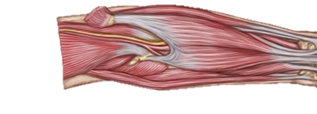
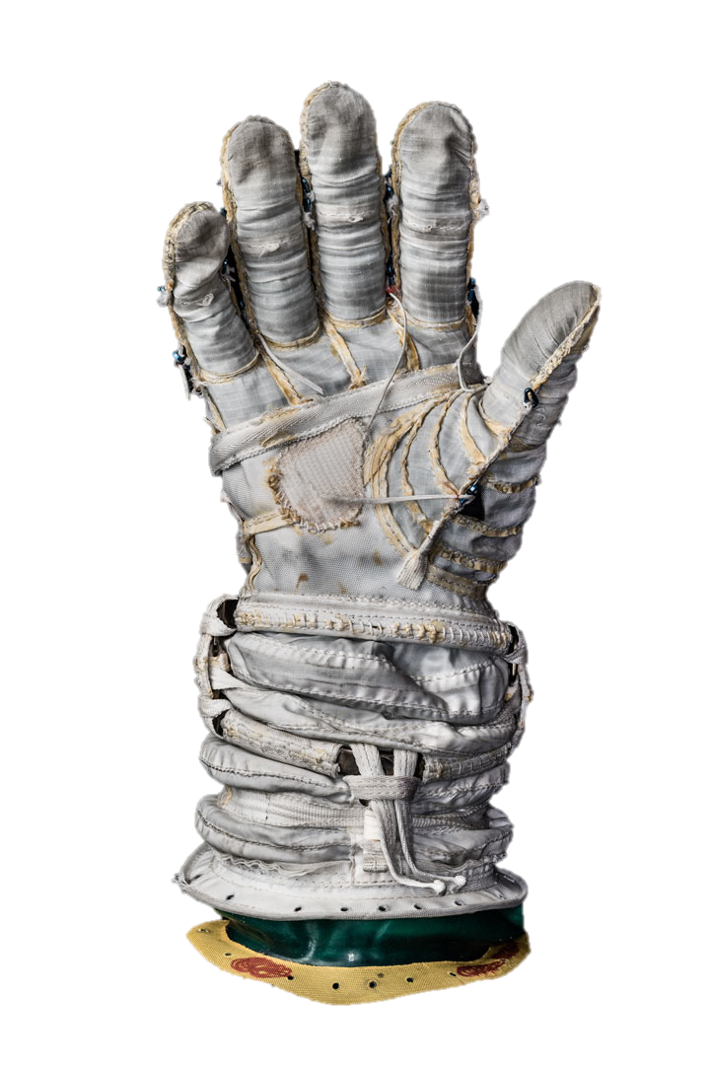
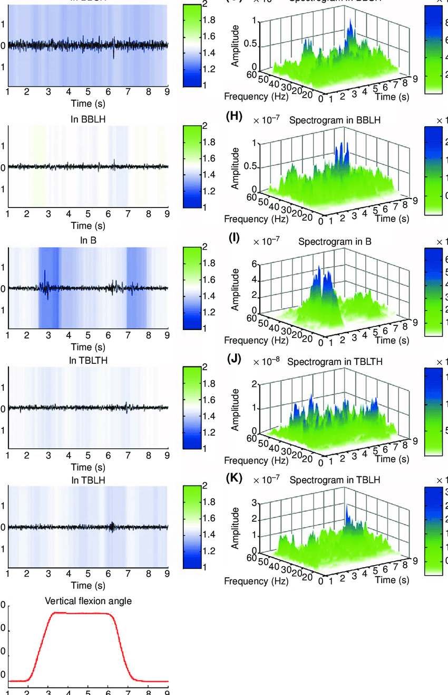
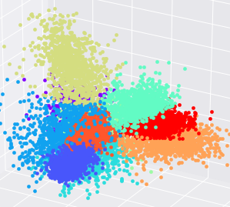
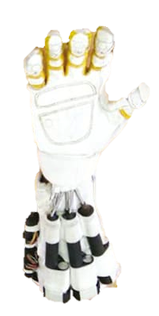
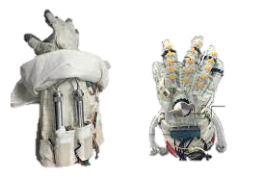
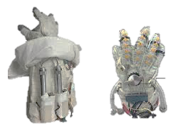
Electromyographic (EMG) Sensing
Extensor digitorum
Flexor digitorum
superficialis
Flexor pollicis brevis
Microcontroller (Data Acquisition)
Data analysis
Spectral Analysis
Machine Learning
Robot Control Signal
Wearable hand devices

Slide 2
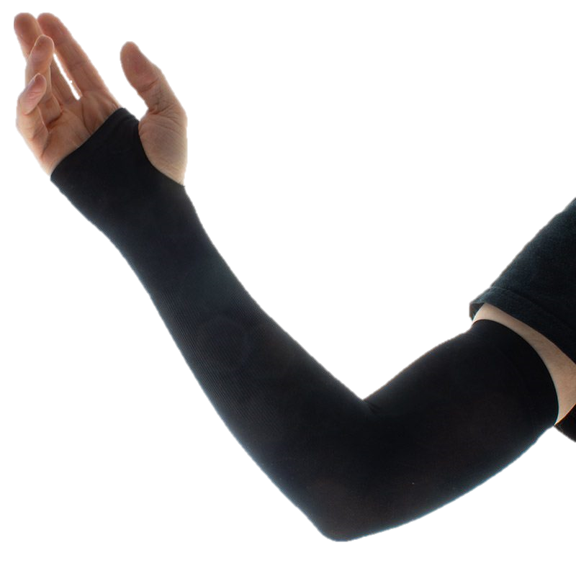
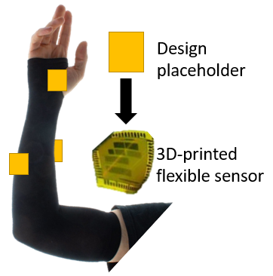
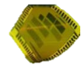
Design placeholder
3D-printed flexible sensor

Slide 3
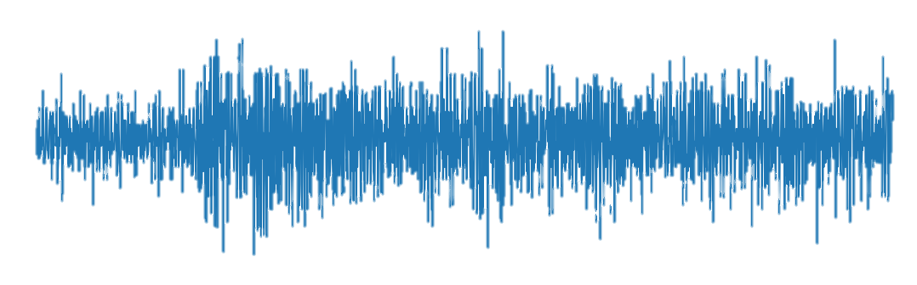
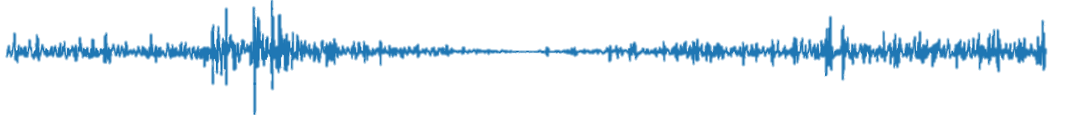
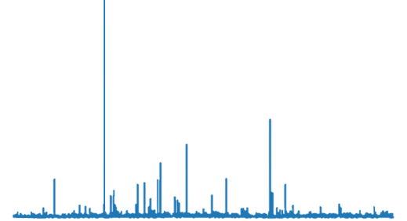
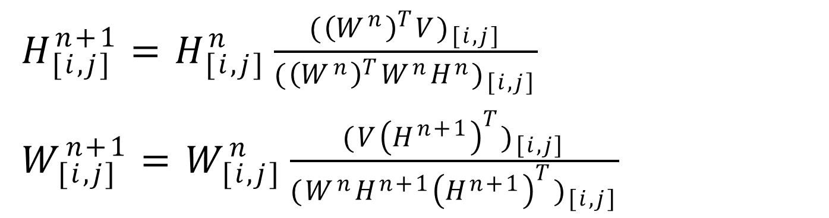
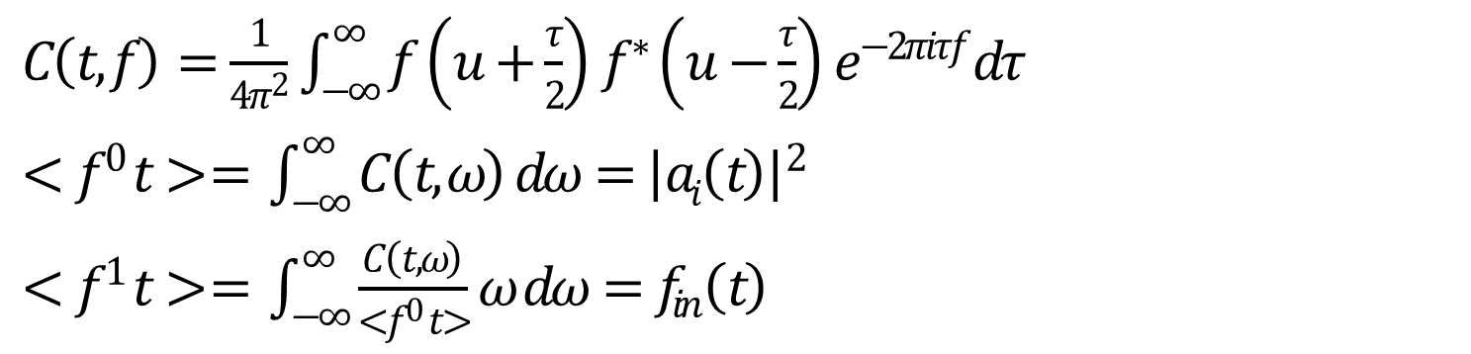
Mathematical summary of Cohen’s Bilinear joint time frequency distribution Method:
$C\left(t,f\right)=\frac{1}{4π^{2}}\int_{−∞}^{∞}{f}\left(u+\frac{τ}{2}\right)f^{∗}\left(u−\frac{τ}{2}\right)e^{−2πiτf}dτ$
$<f^{0} t> = \int_{−∞}^{∞}{C\left(t,ω\right) dω={\left|ai\left(t\right)\right|}^{2}}$
$<f^{1} t> = \int_{−∞}^{∞}{\frac{C\left(t,ω\right)}{<f^{0} t>}ω dω=f_{in}\left(t\right)}$
Hand pose
Fatigue detected
Summary of NNMF method:
Pose detected
$H_{[i,j]}^{n+1}=H_{[i,j]}^{n}\frac{{({\left(W^{n}\right)}^{T}V)}_{[i,j]}}{{({\left(W^{n}\right)}^{T}W^{n}H^{n})}_{[i,j]}}$
$W_{[i,j]}^{n+1}=W_{[i,j]}^{n}\frac{{(V{\left(H^{n+1}\right)}^{T})}_{[i,j]}}{{(W^{n}H^{n+1}{\left(H^{n+1}\right)}^{T})}_{[i,j]}}$

Slide 4
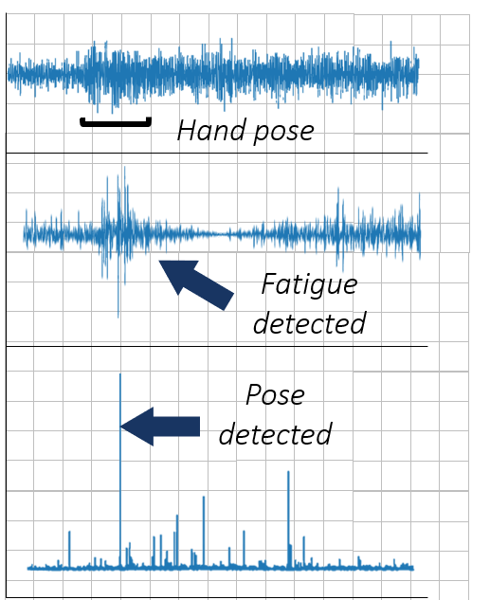
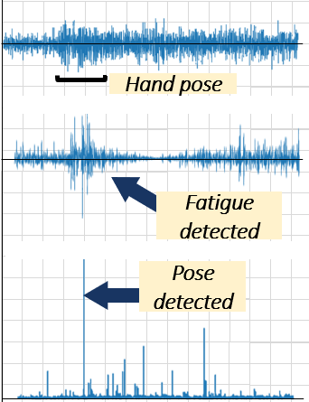
Hand pose
Fatigue detected
Pose detected

Slide 5
Hand pose
Fatigue detected
Pose detected

Slide 6
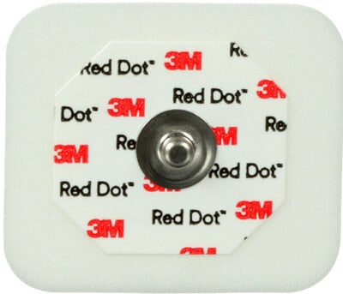
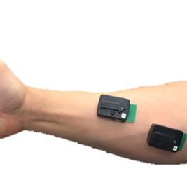
A.
B.
Delsys Trigno EMG system

Slide 7
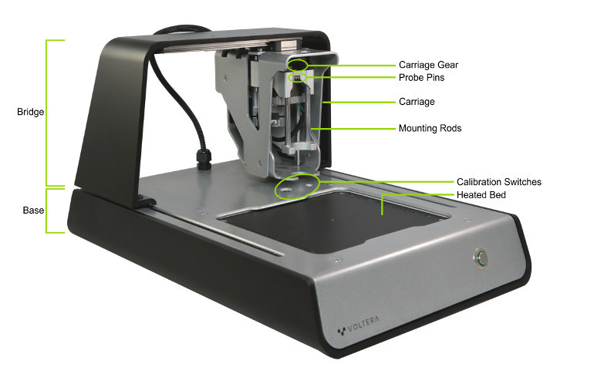
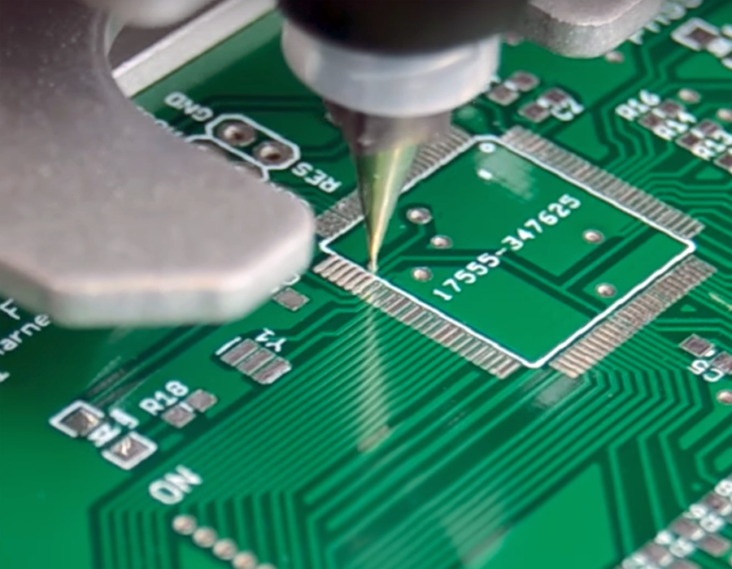

Slide 8
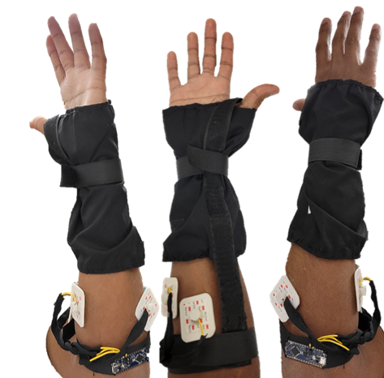
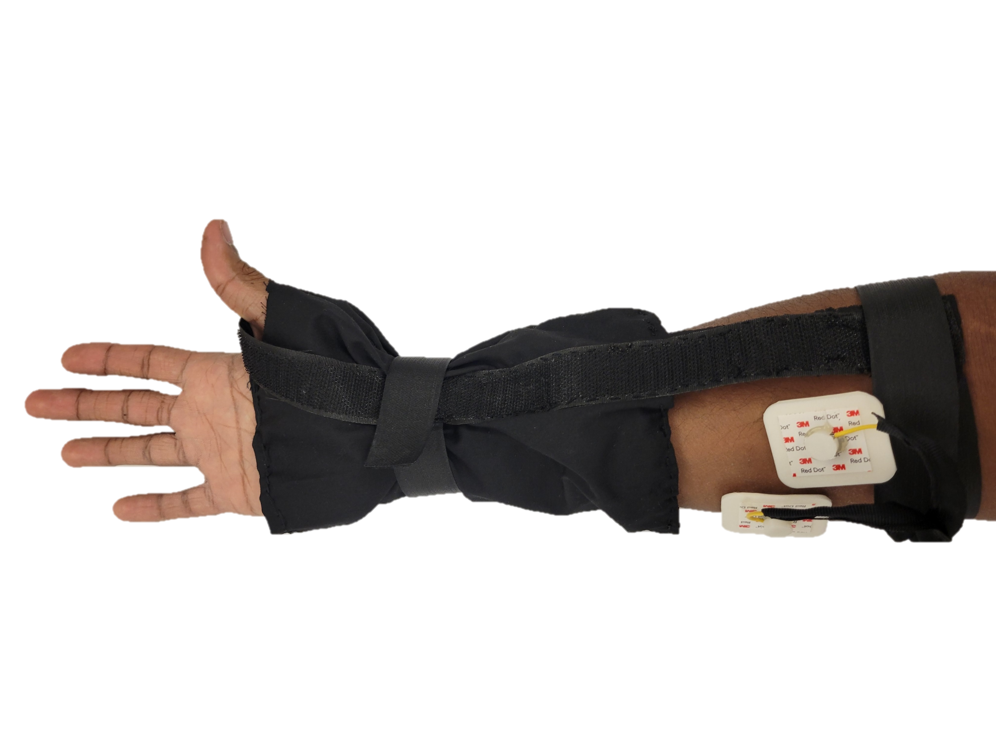
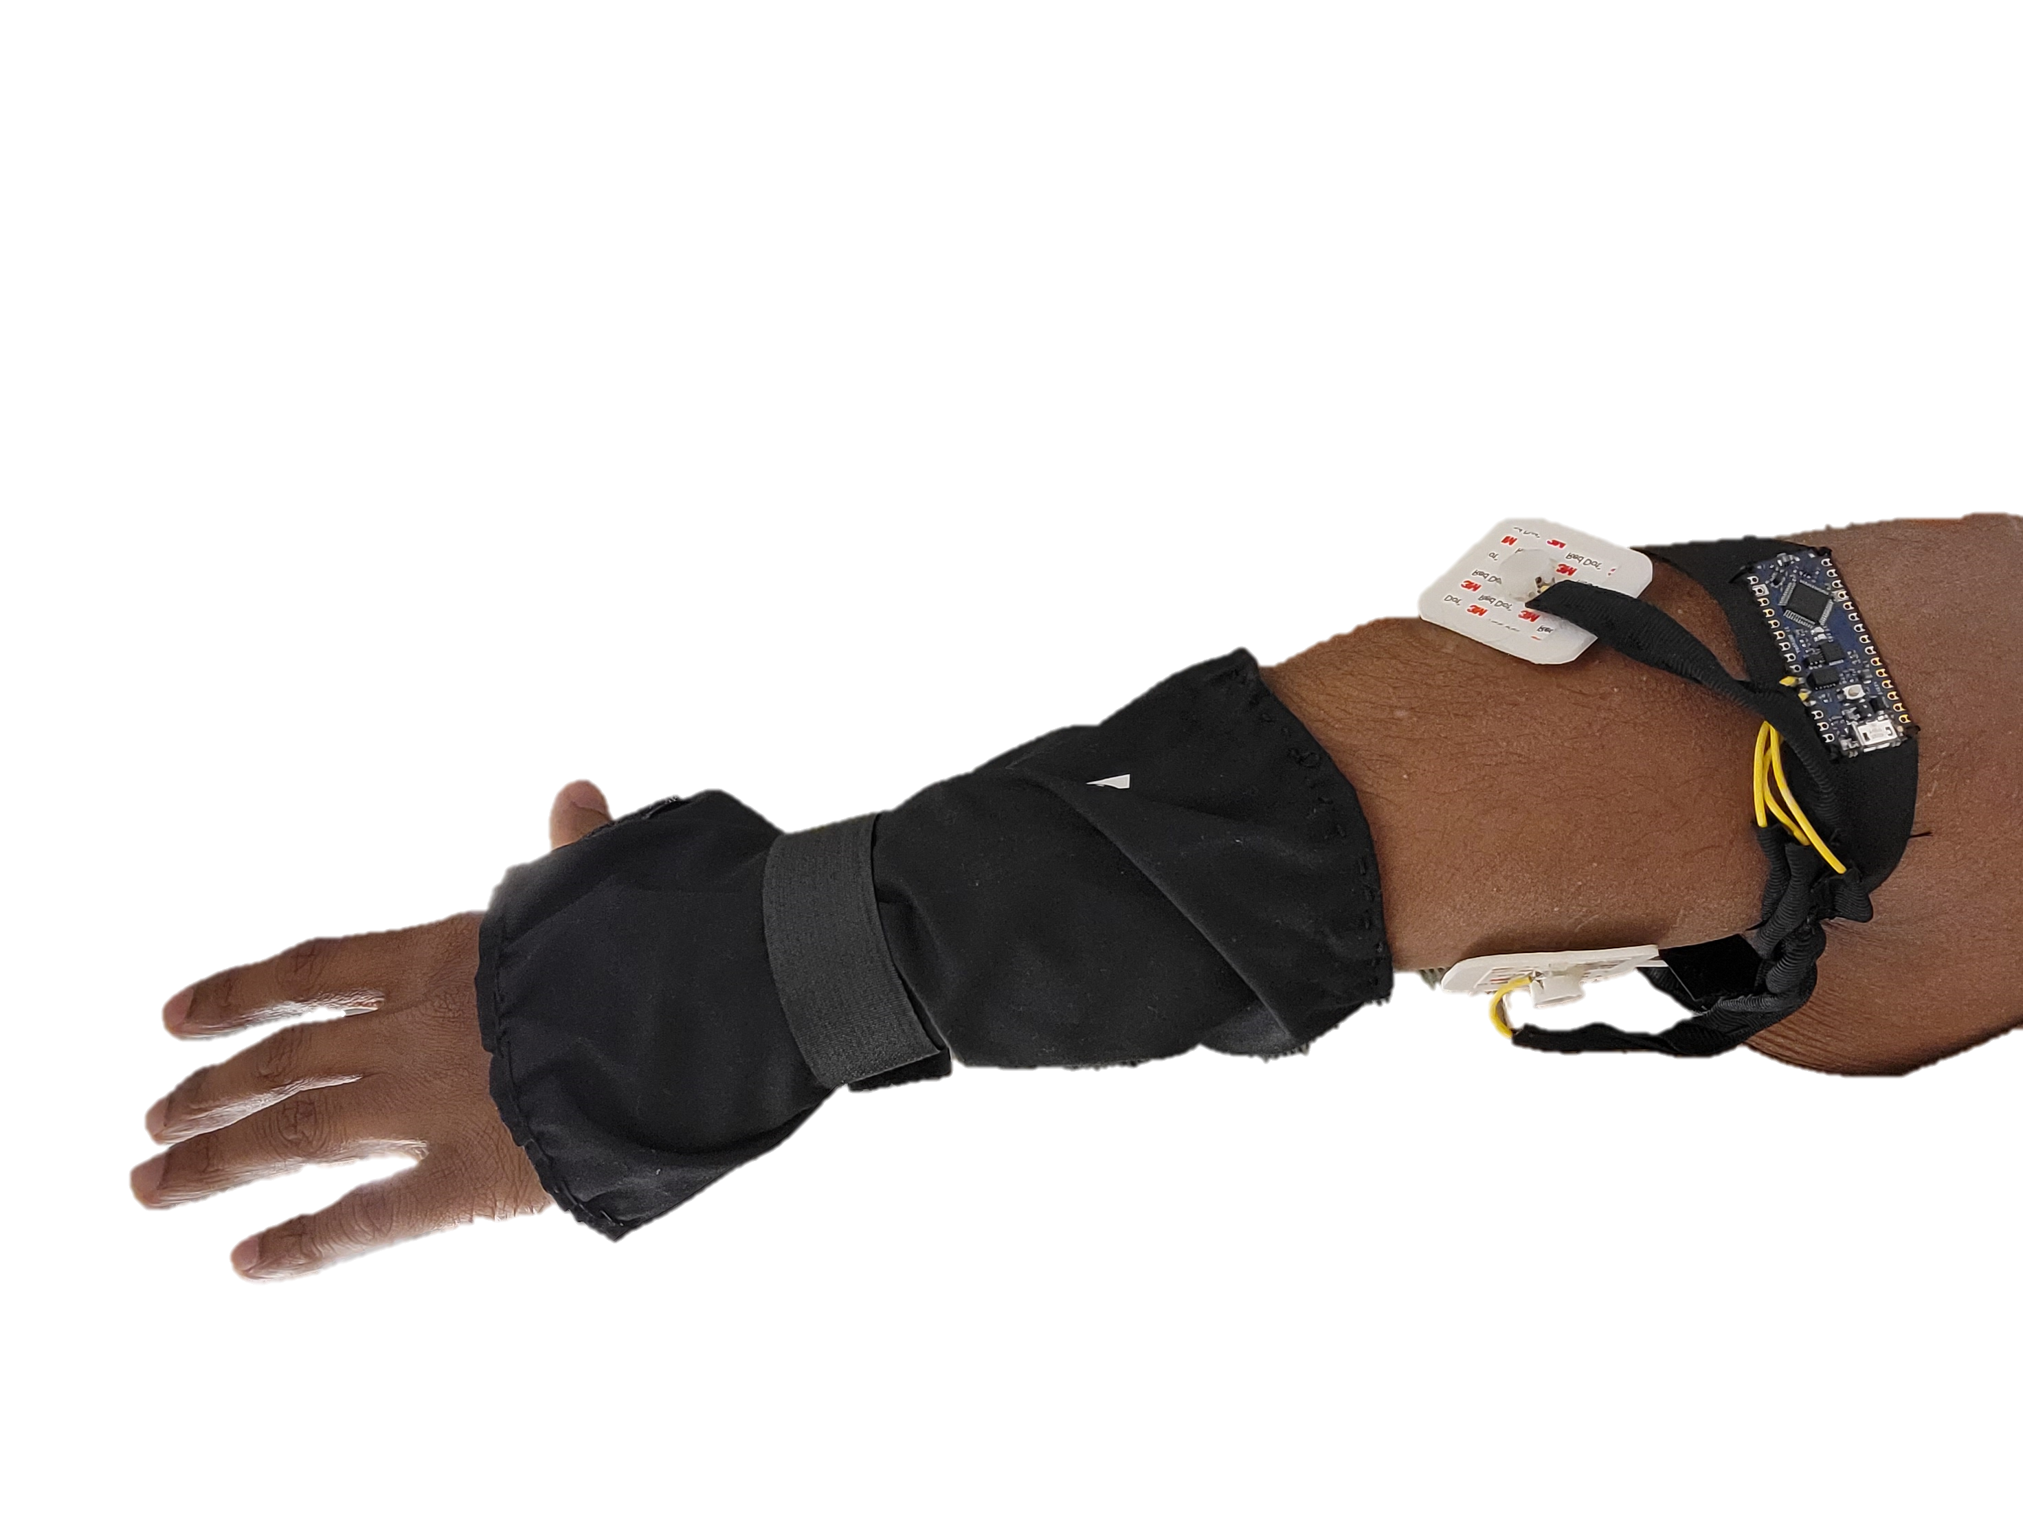
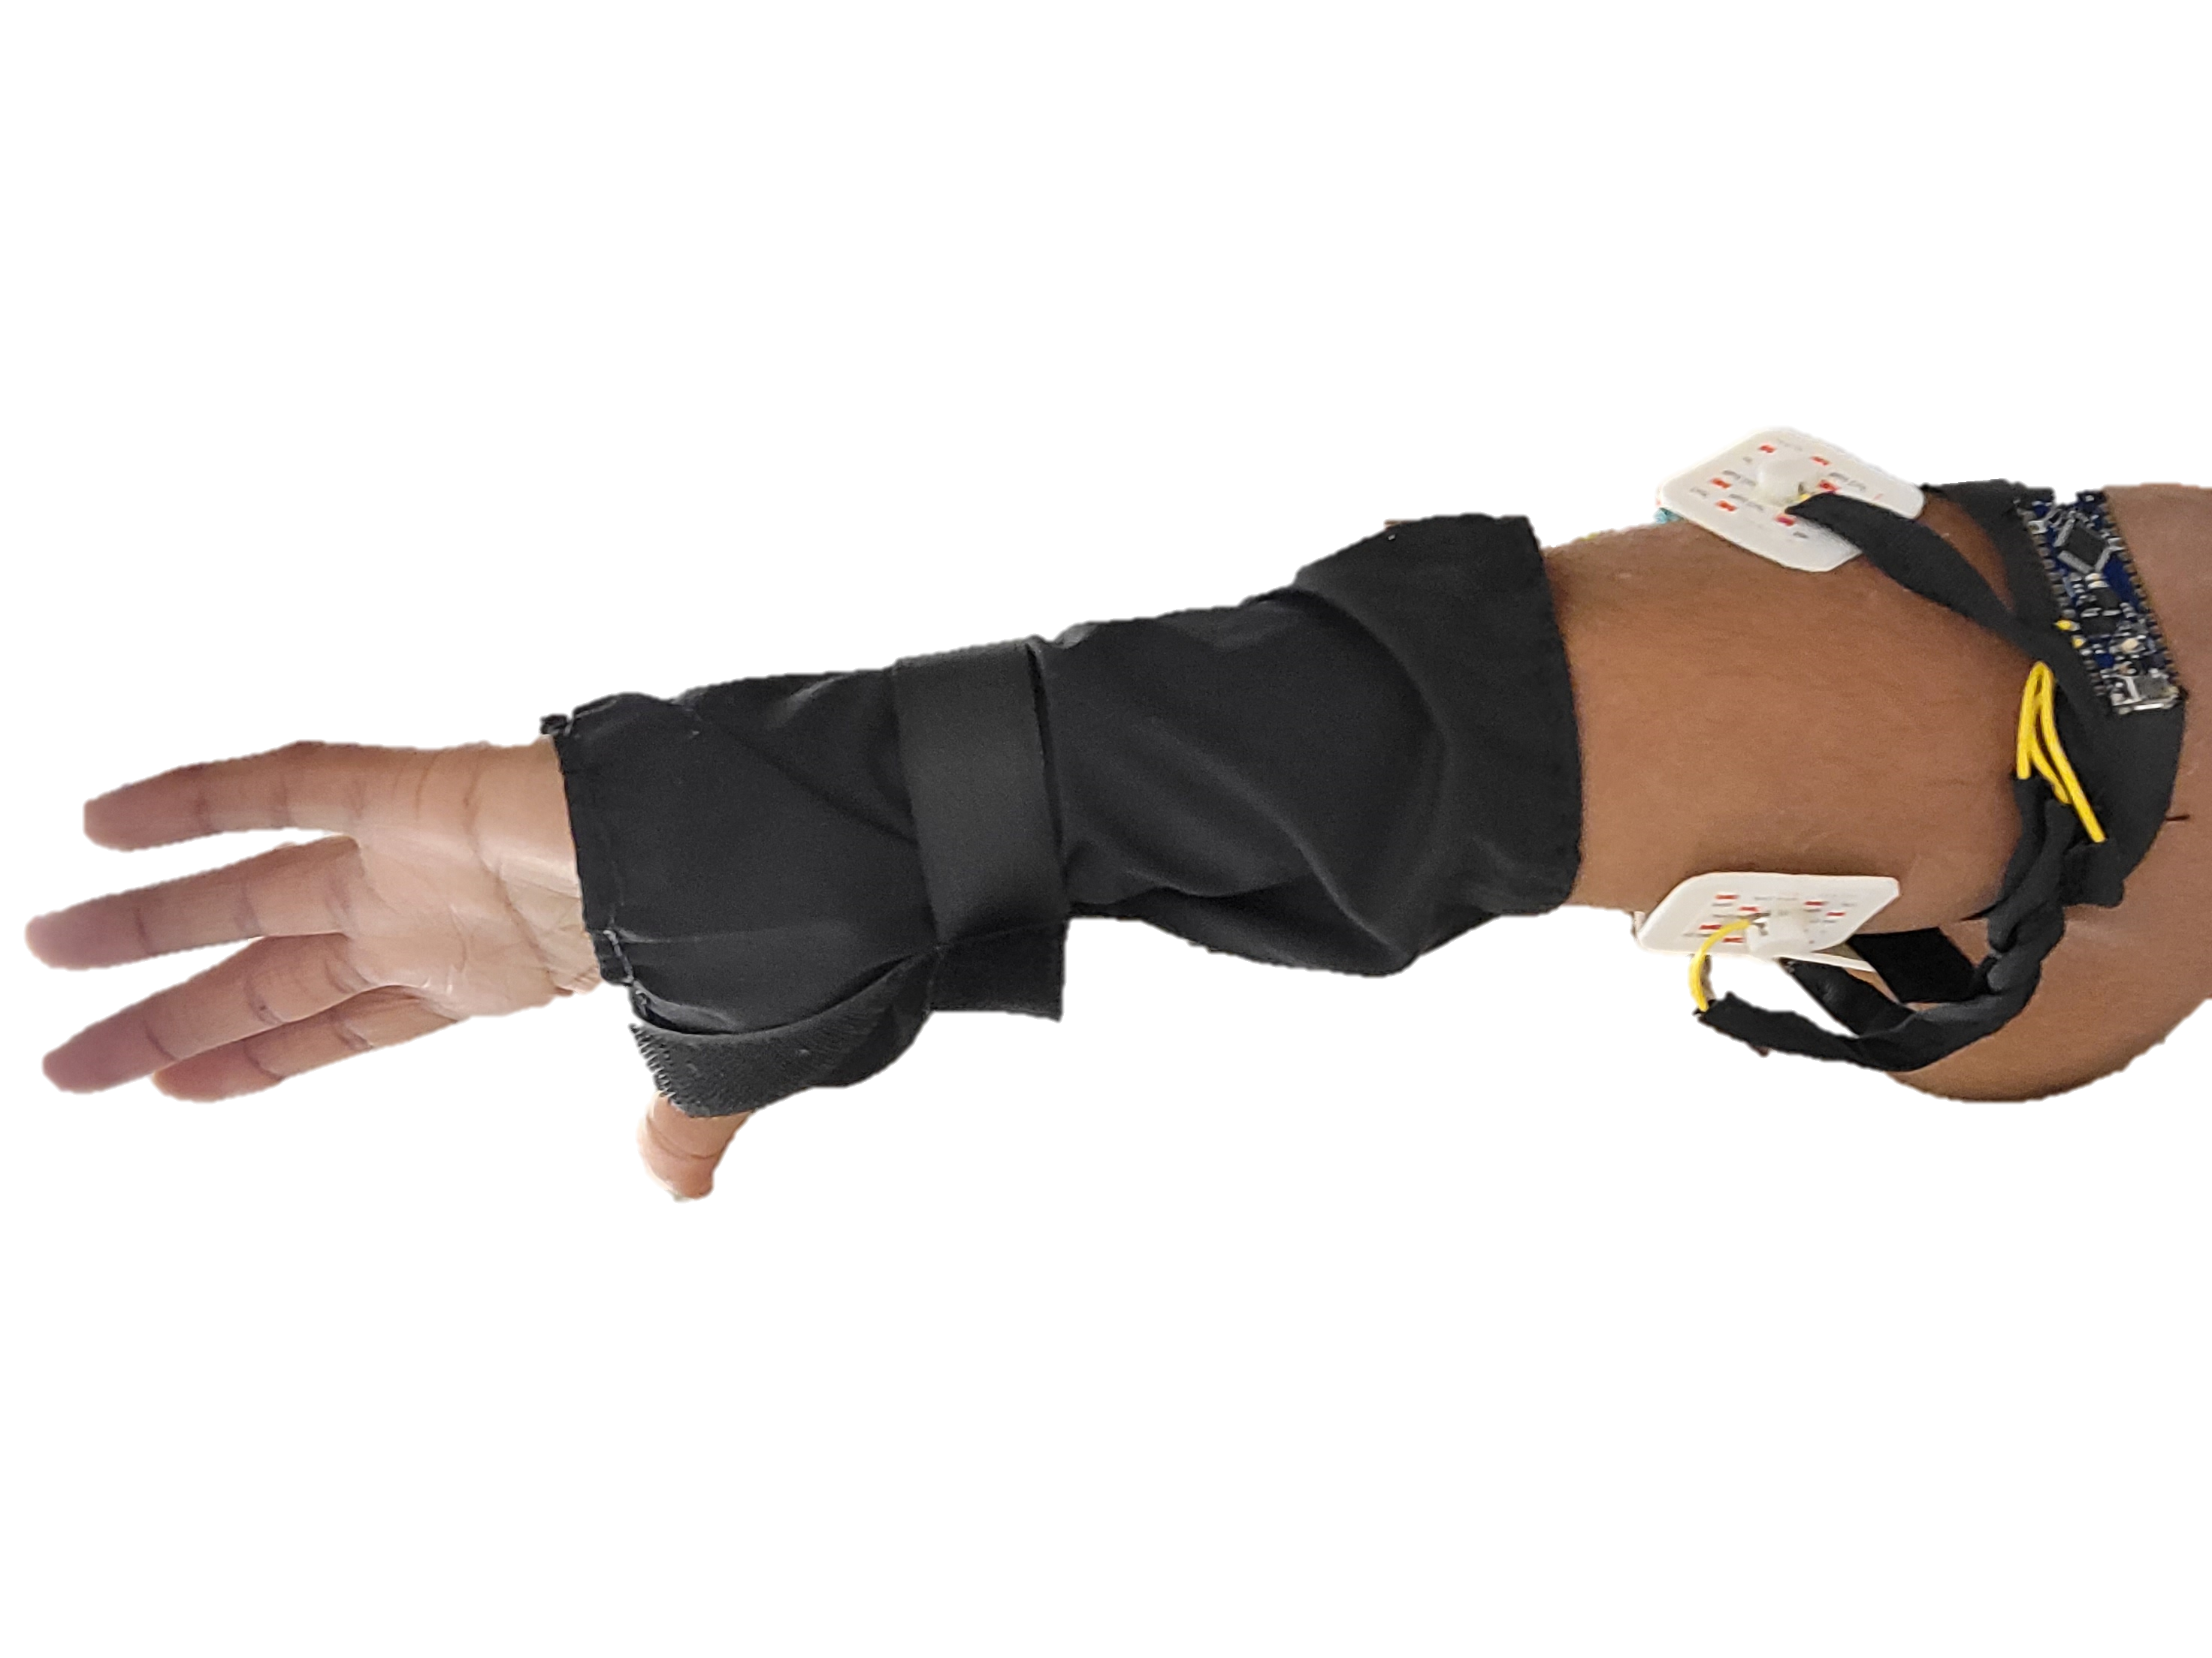
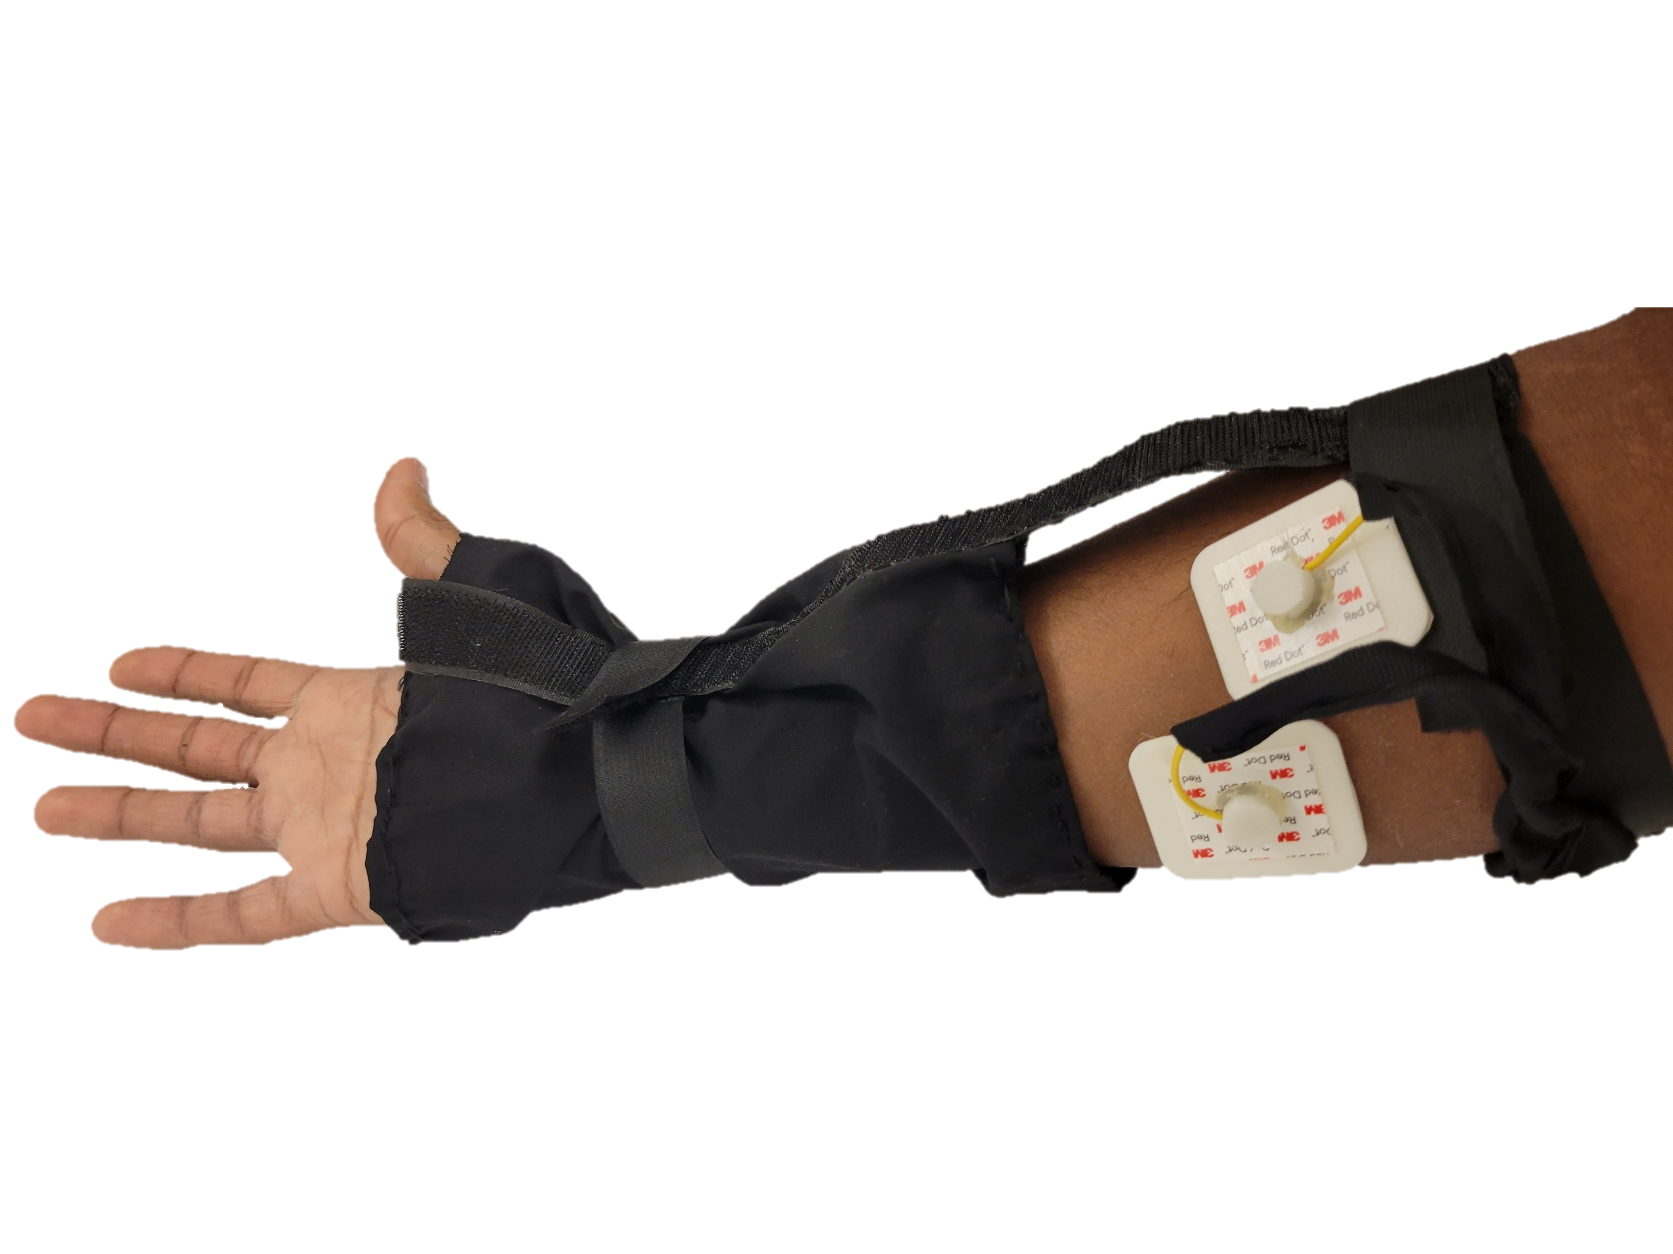

Slide 9
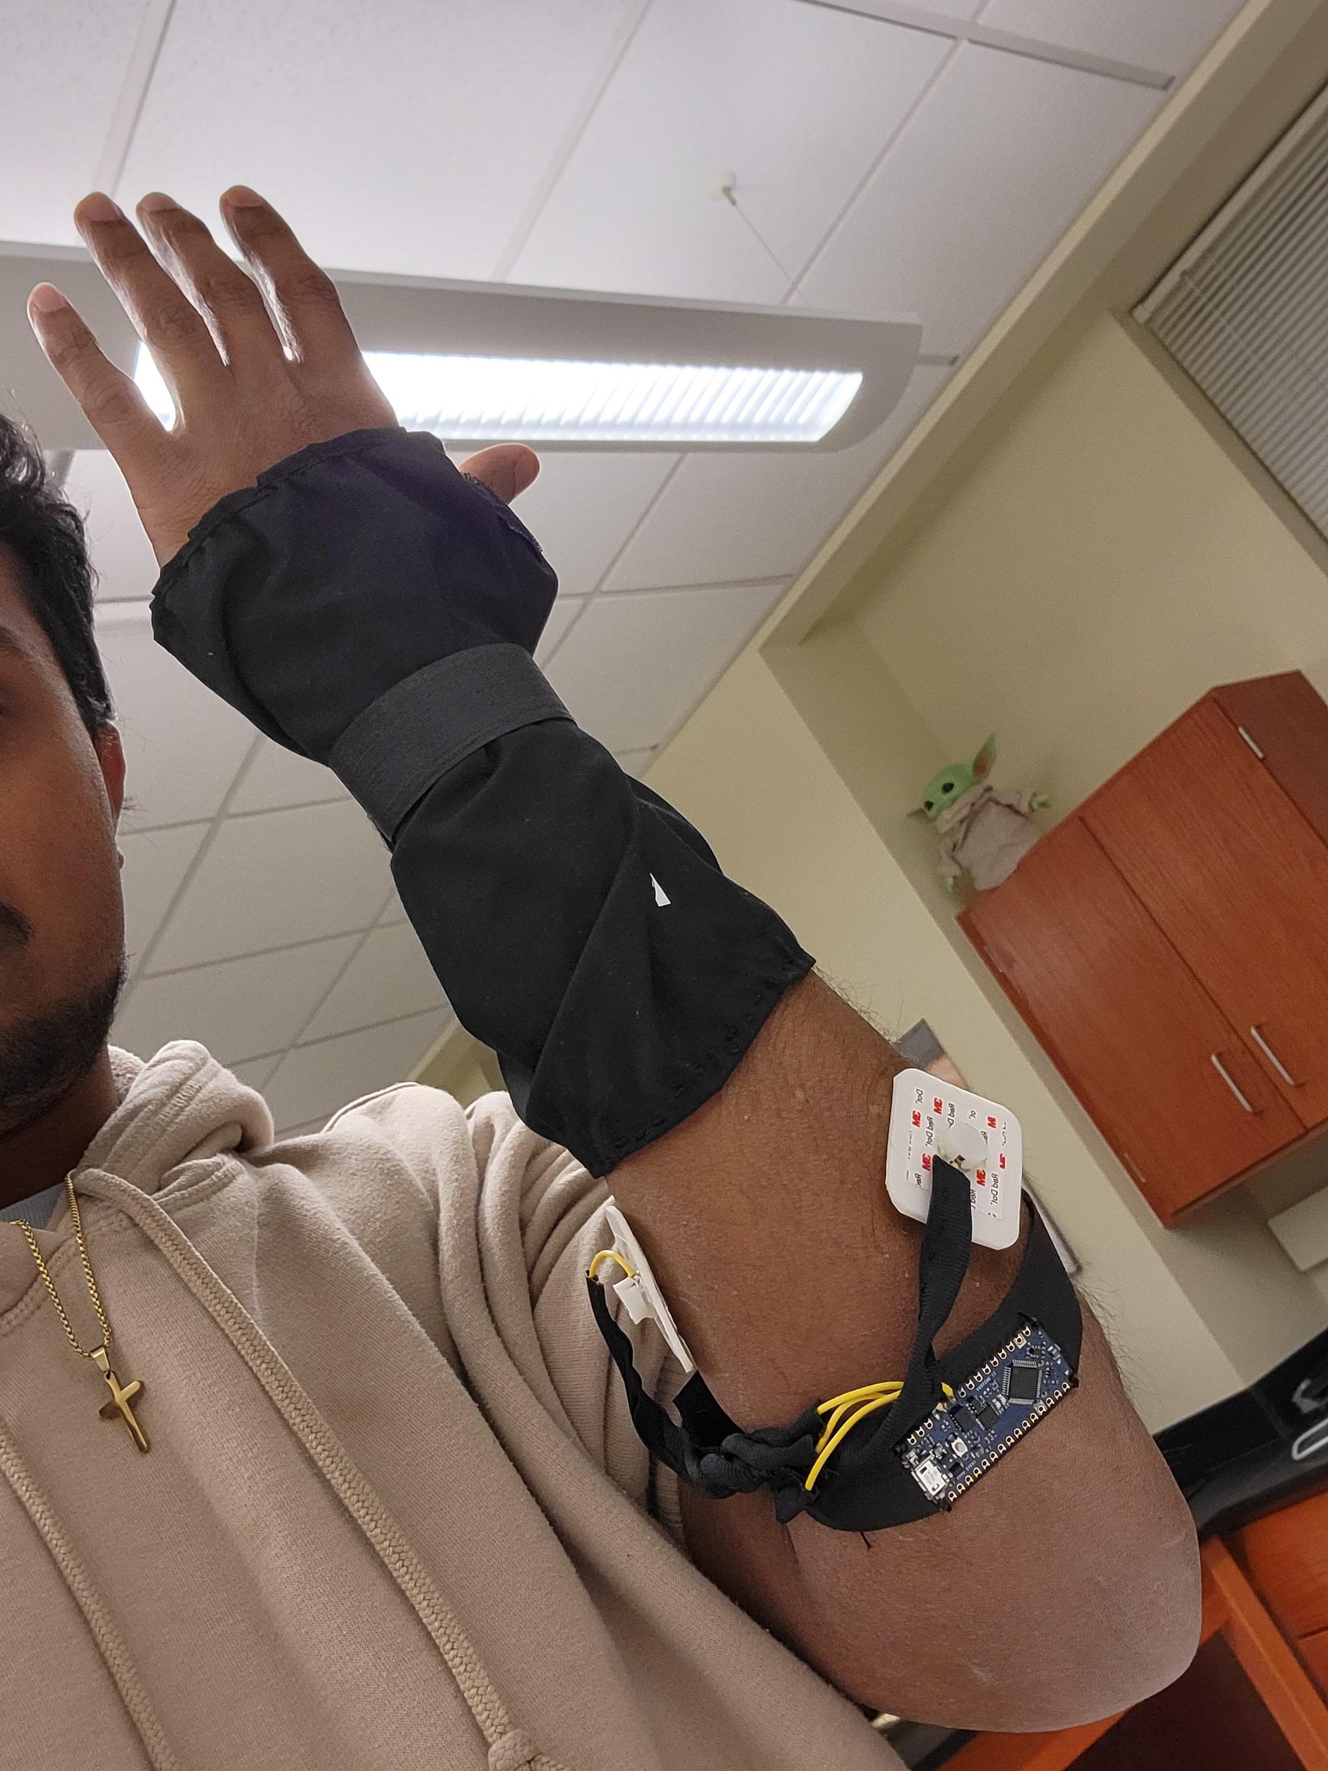
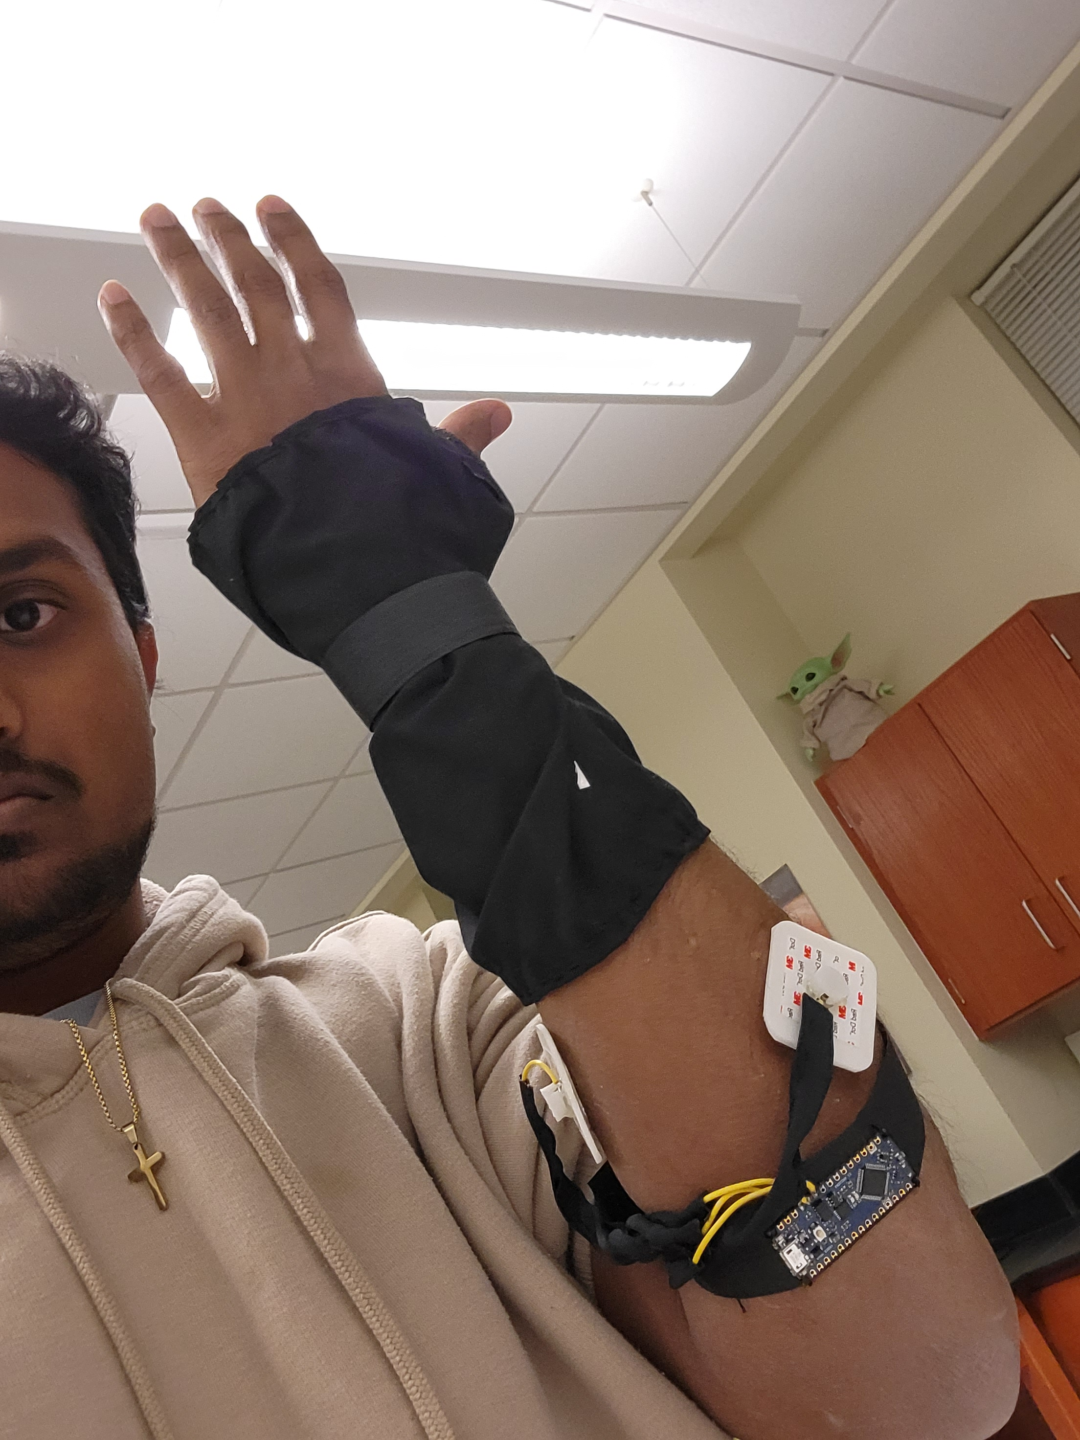

Slide 10
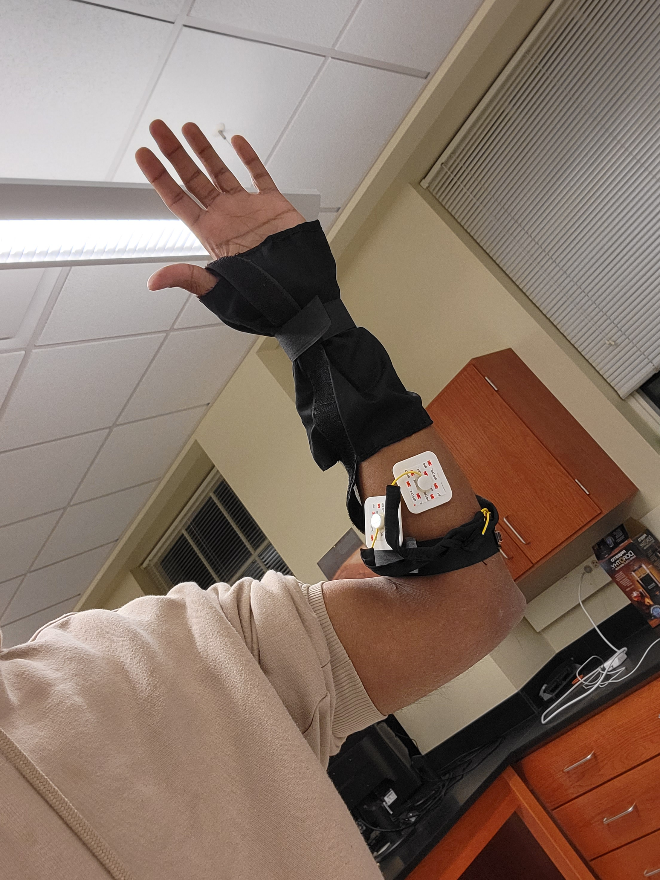
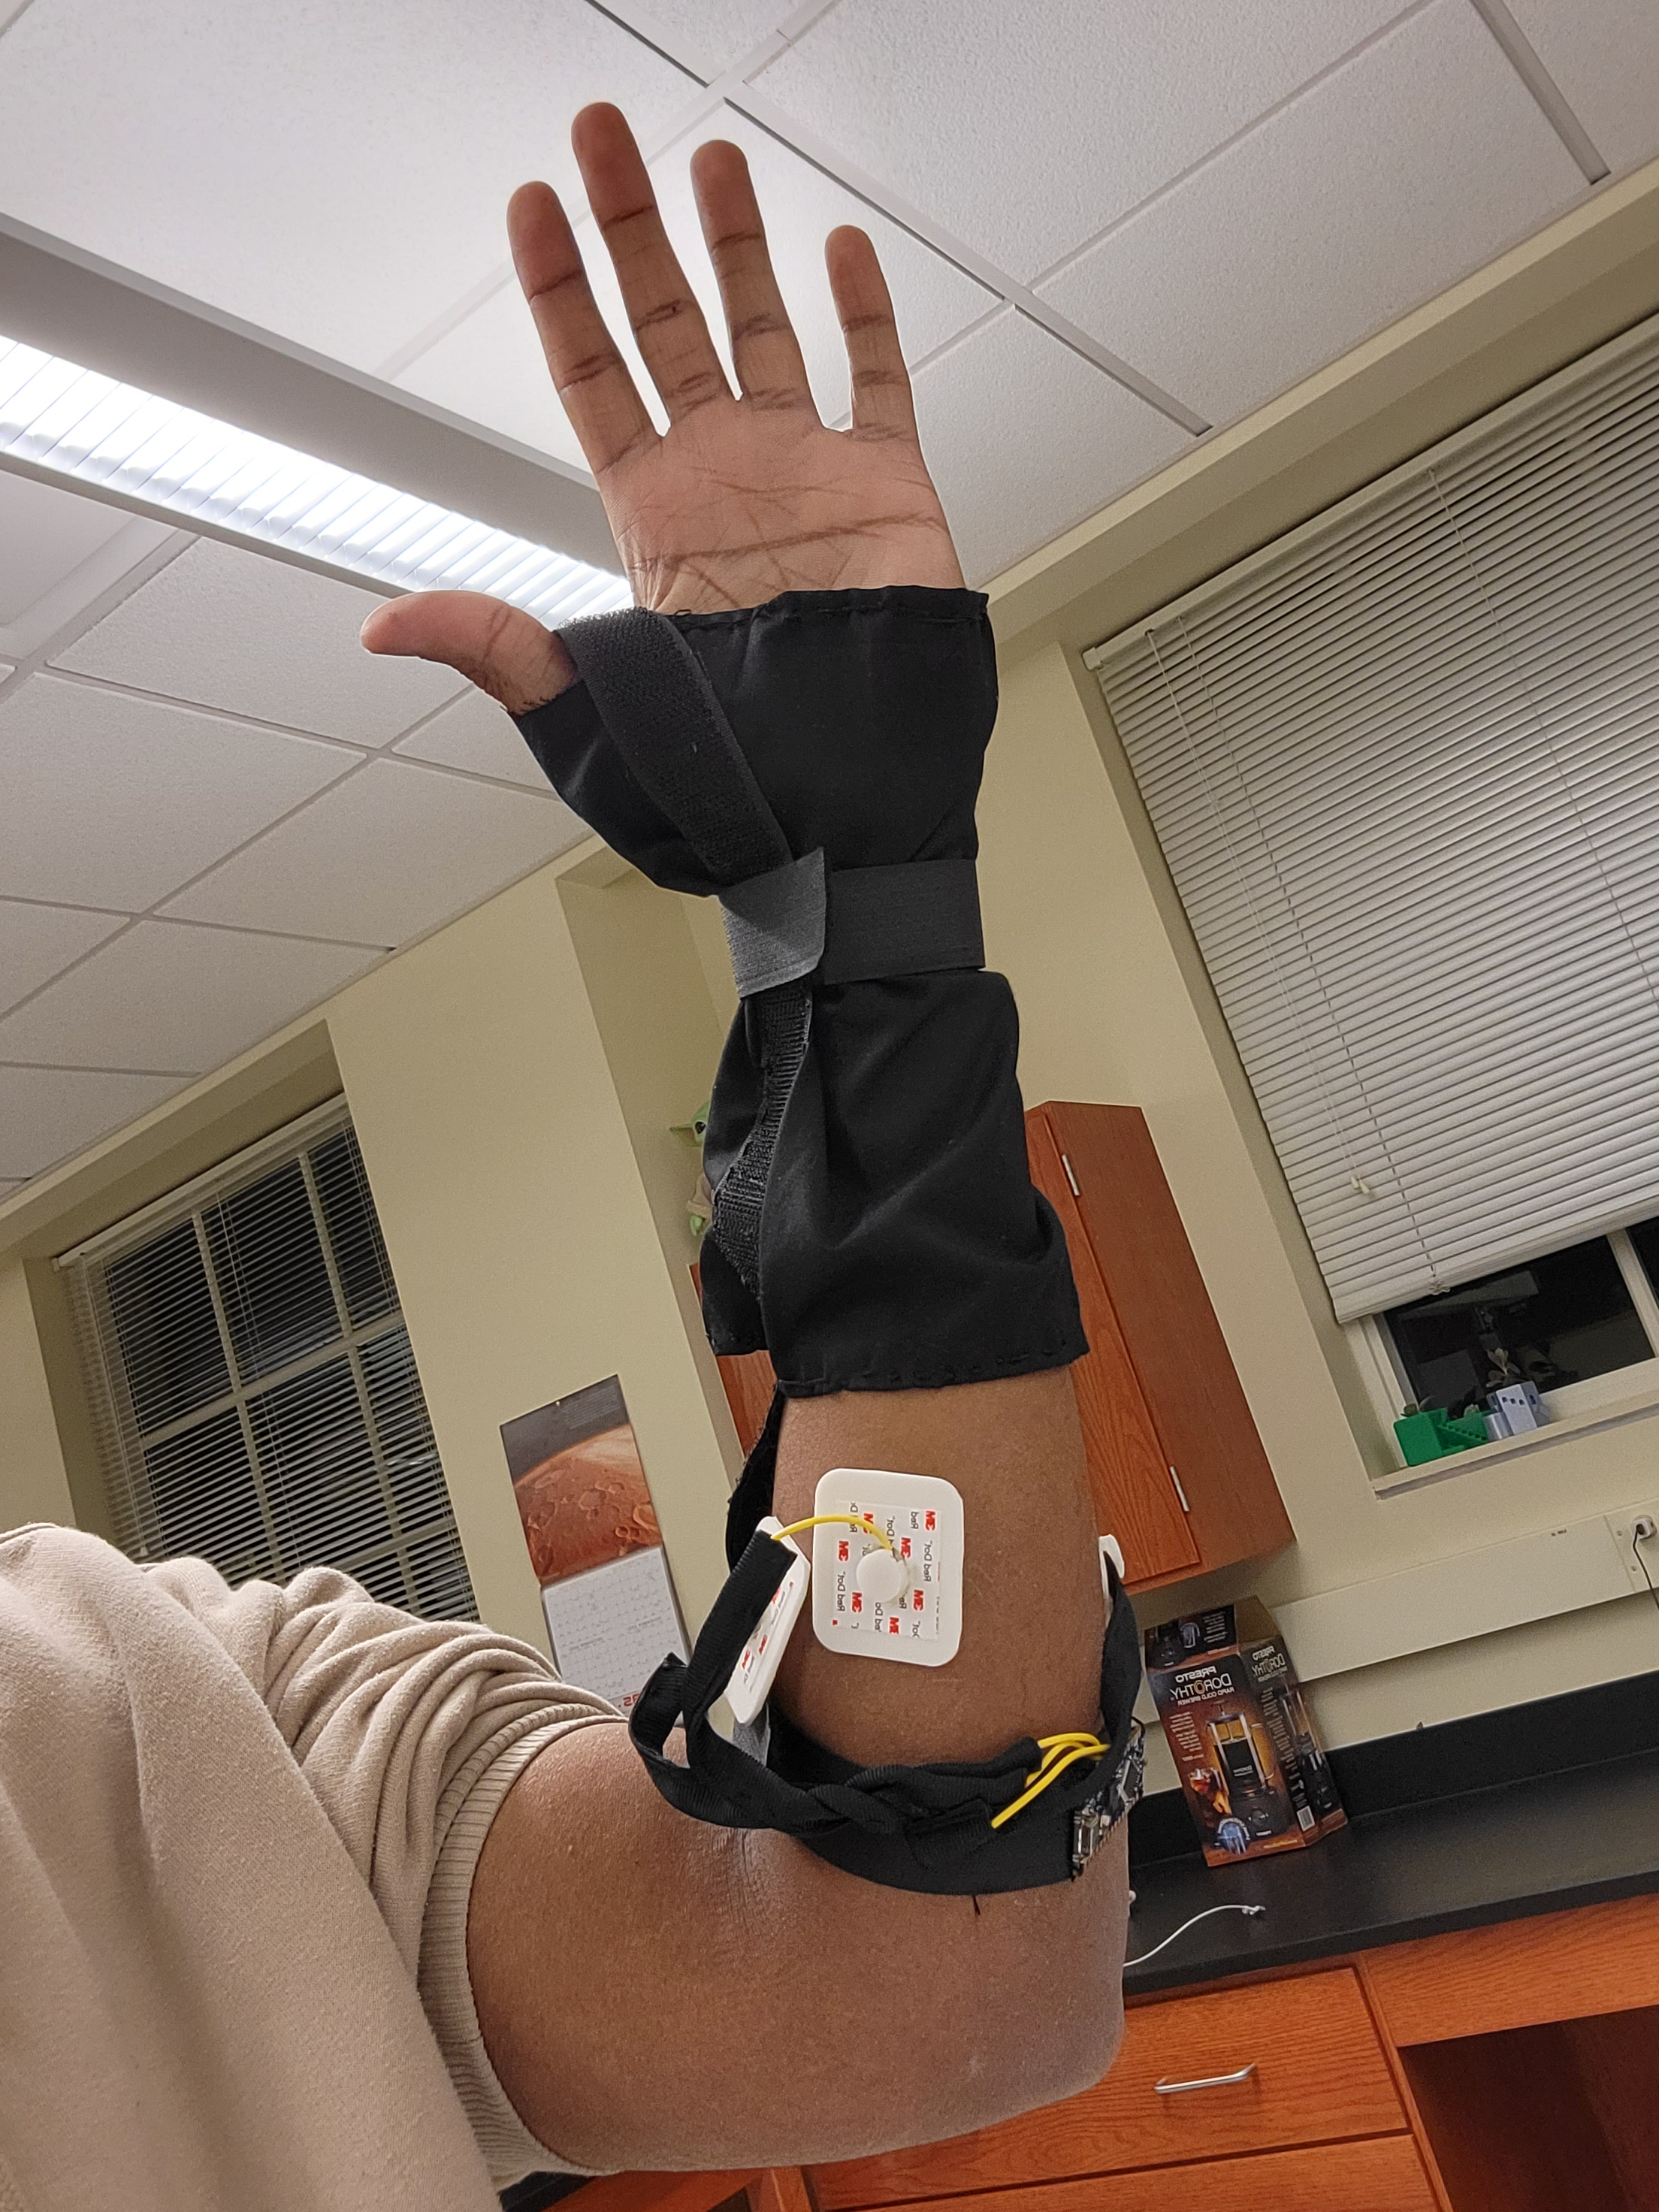
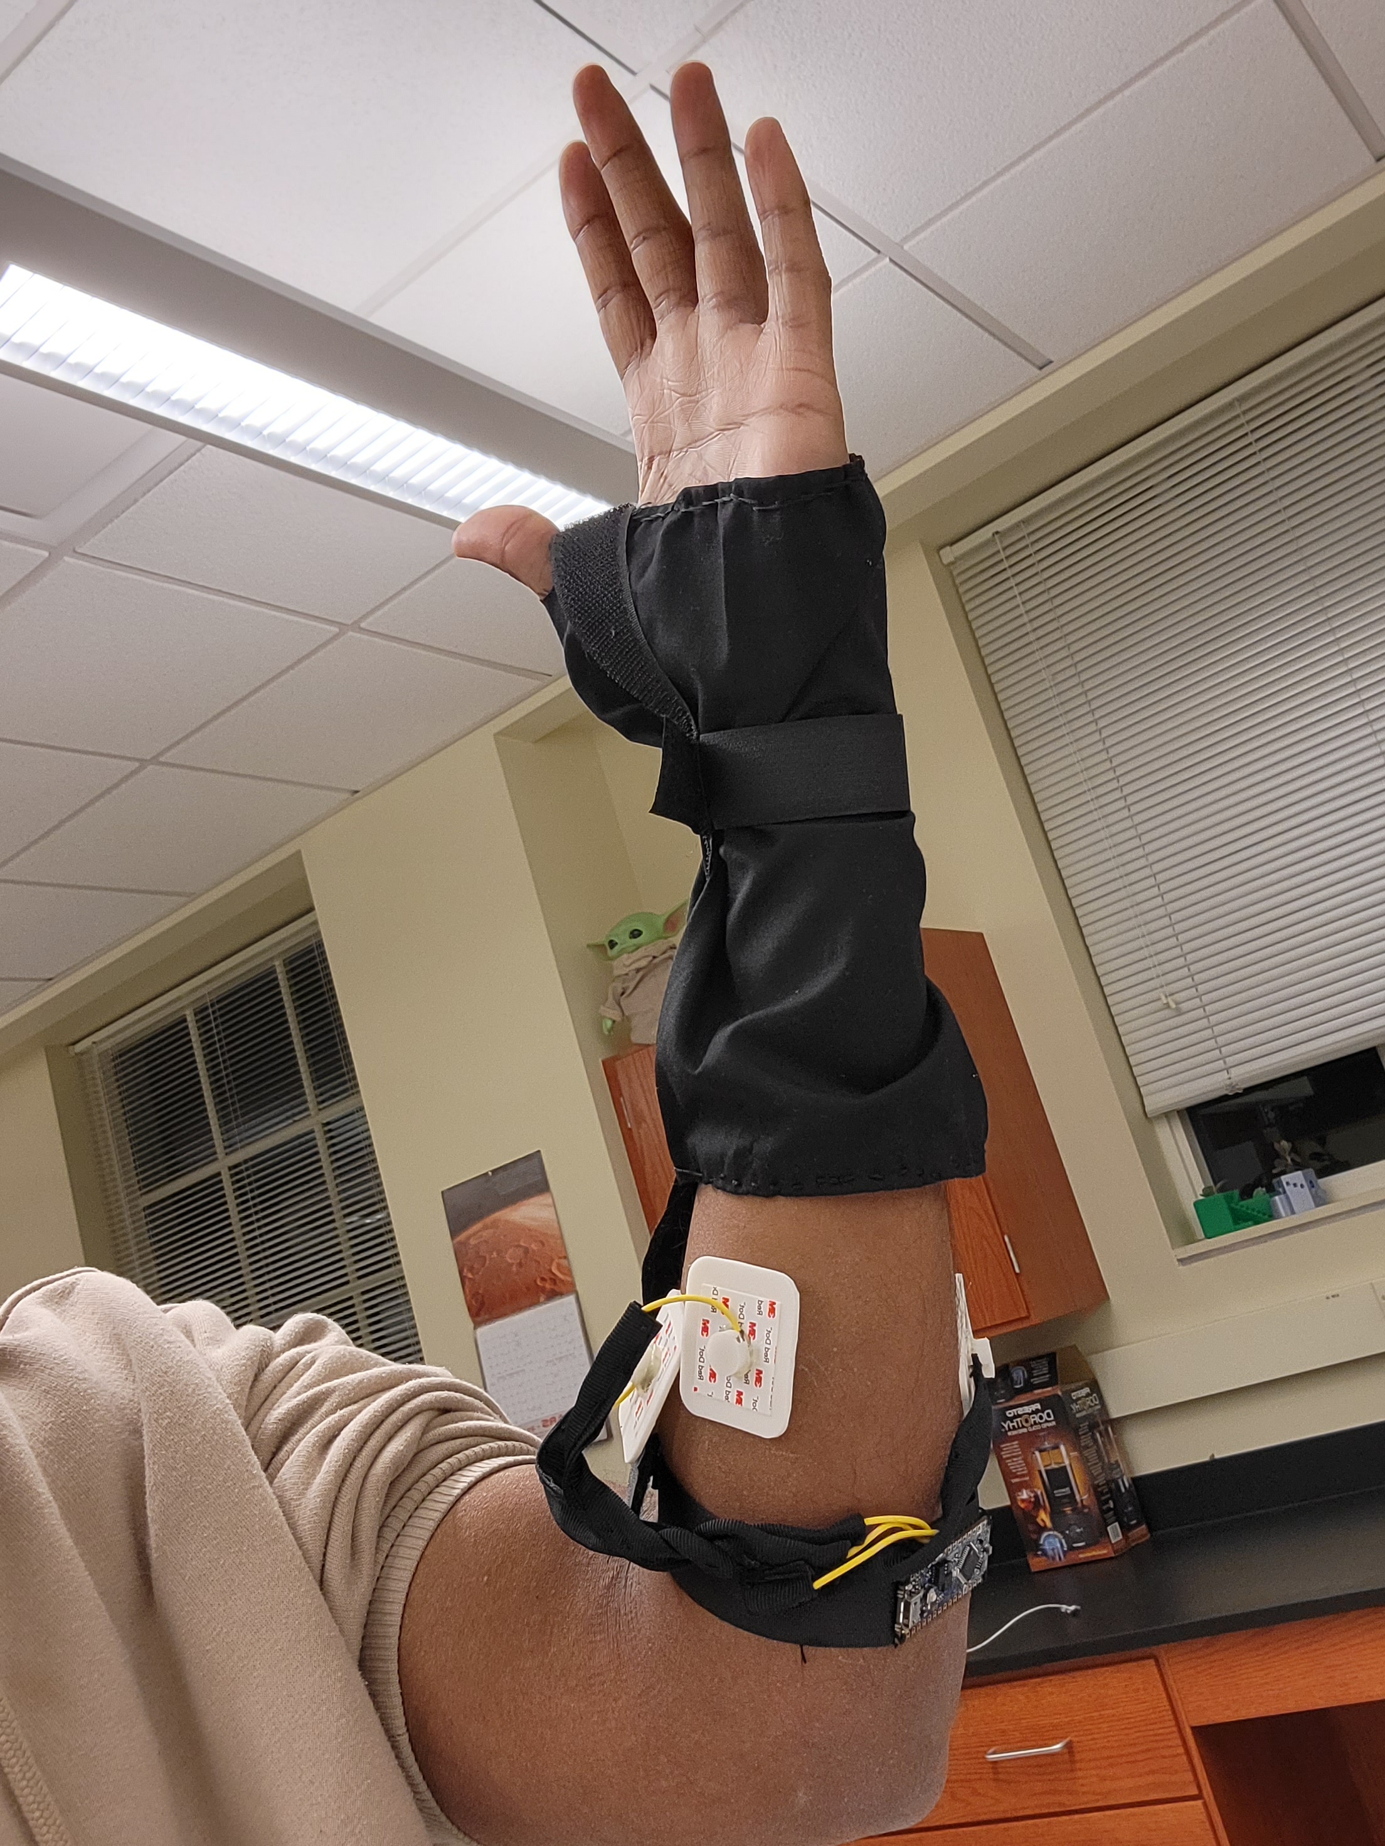

Slide 11
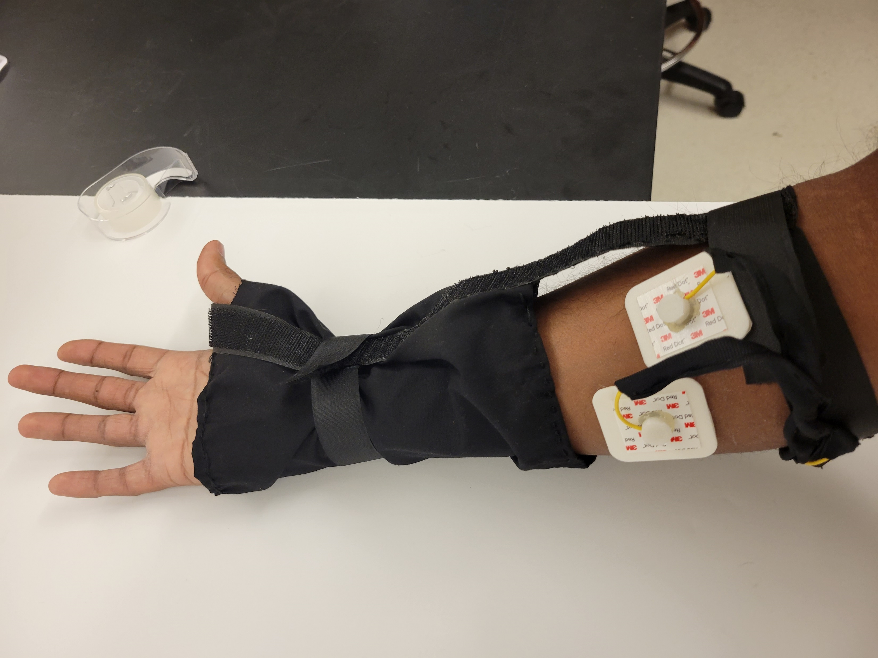

Slide 12
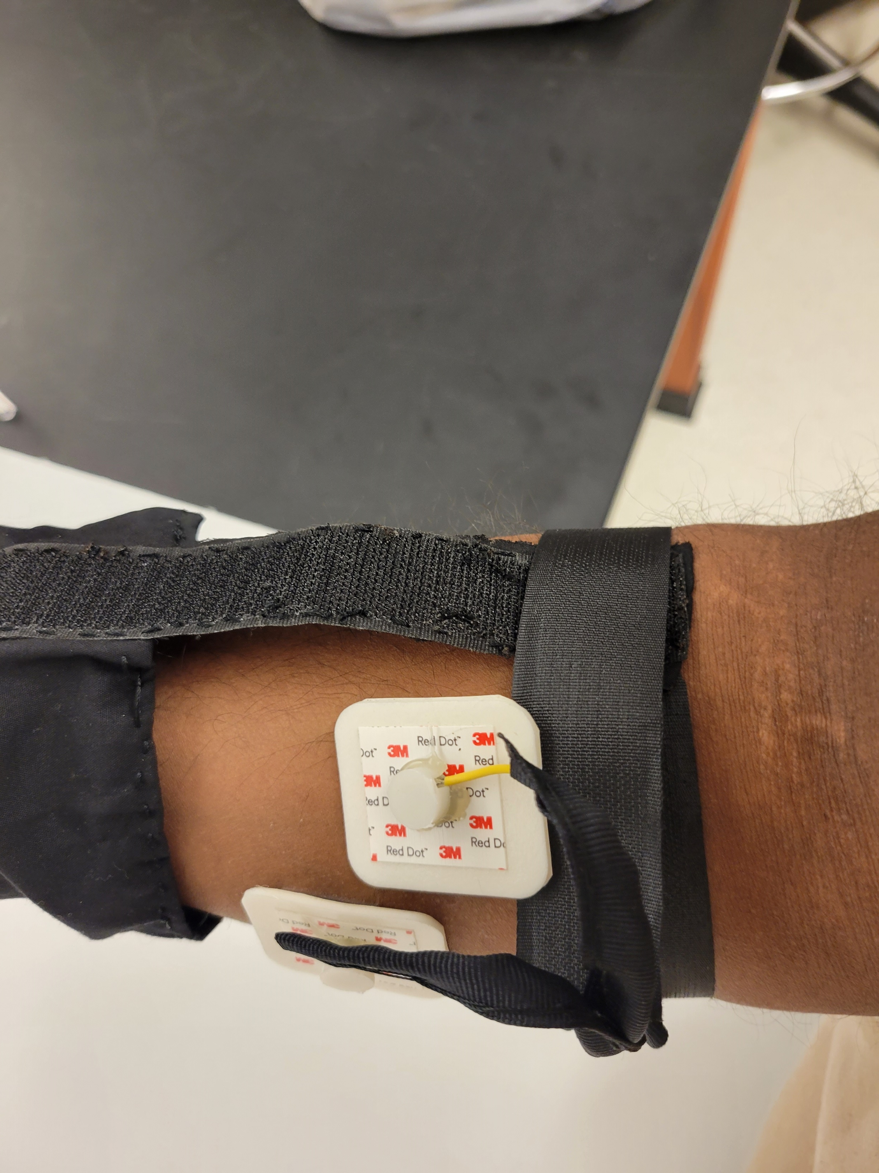

Slide 13
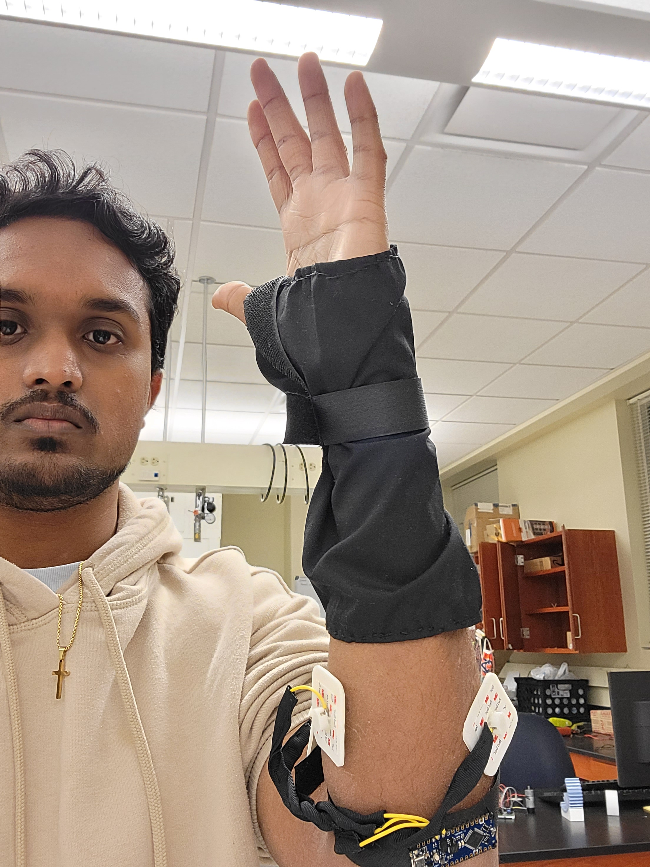
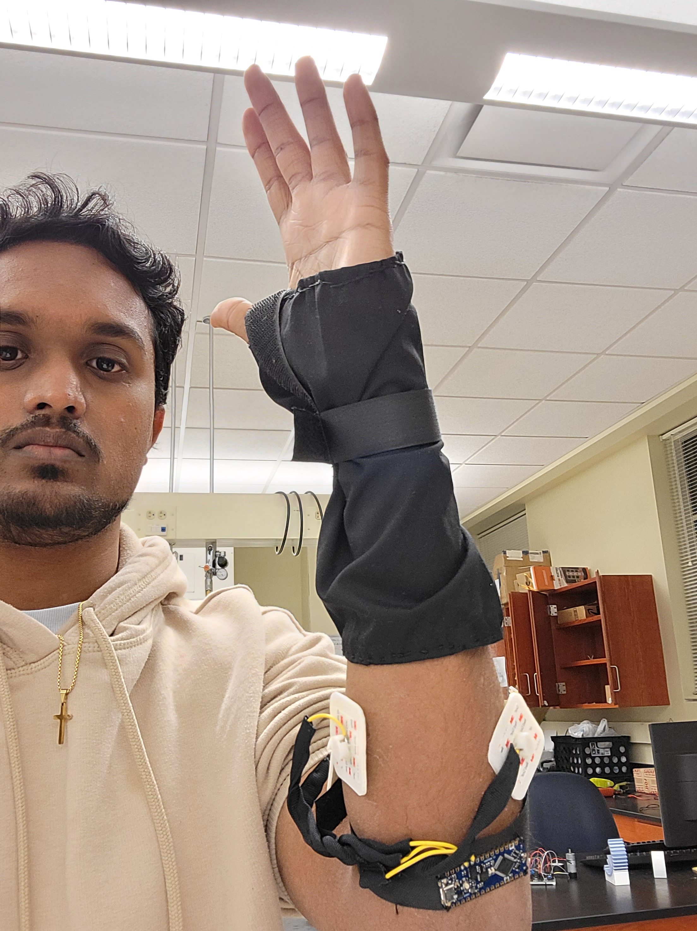
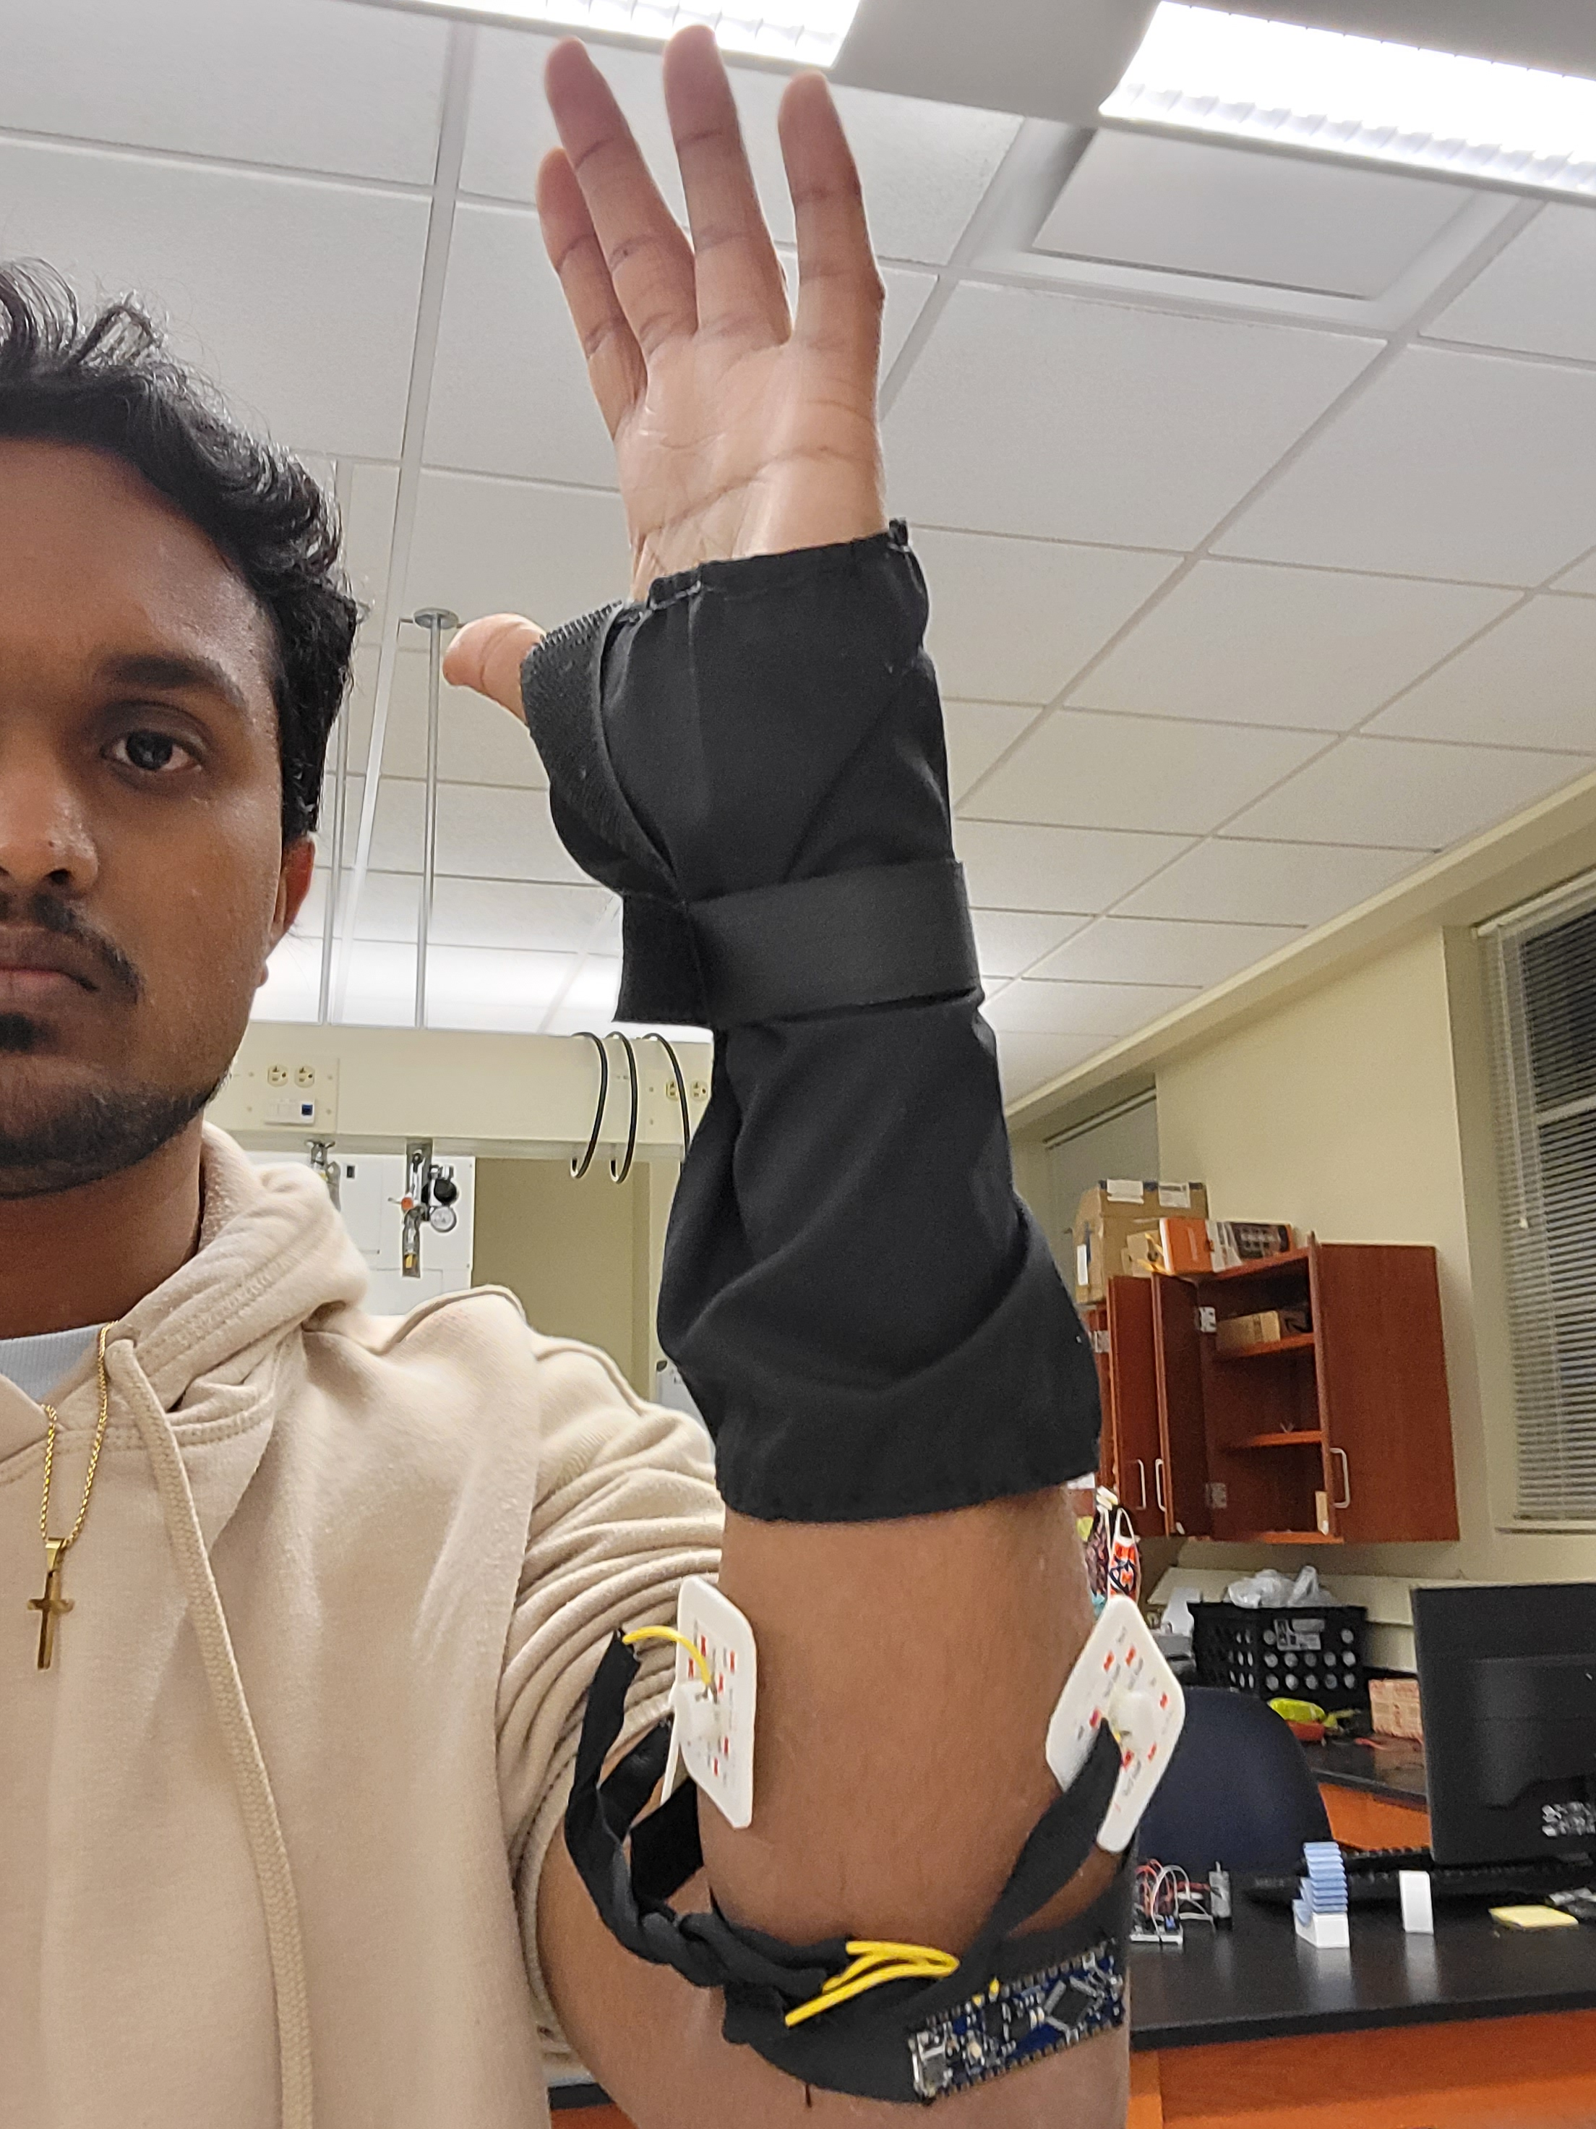

Slide 14
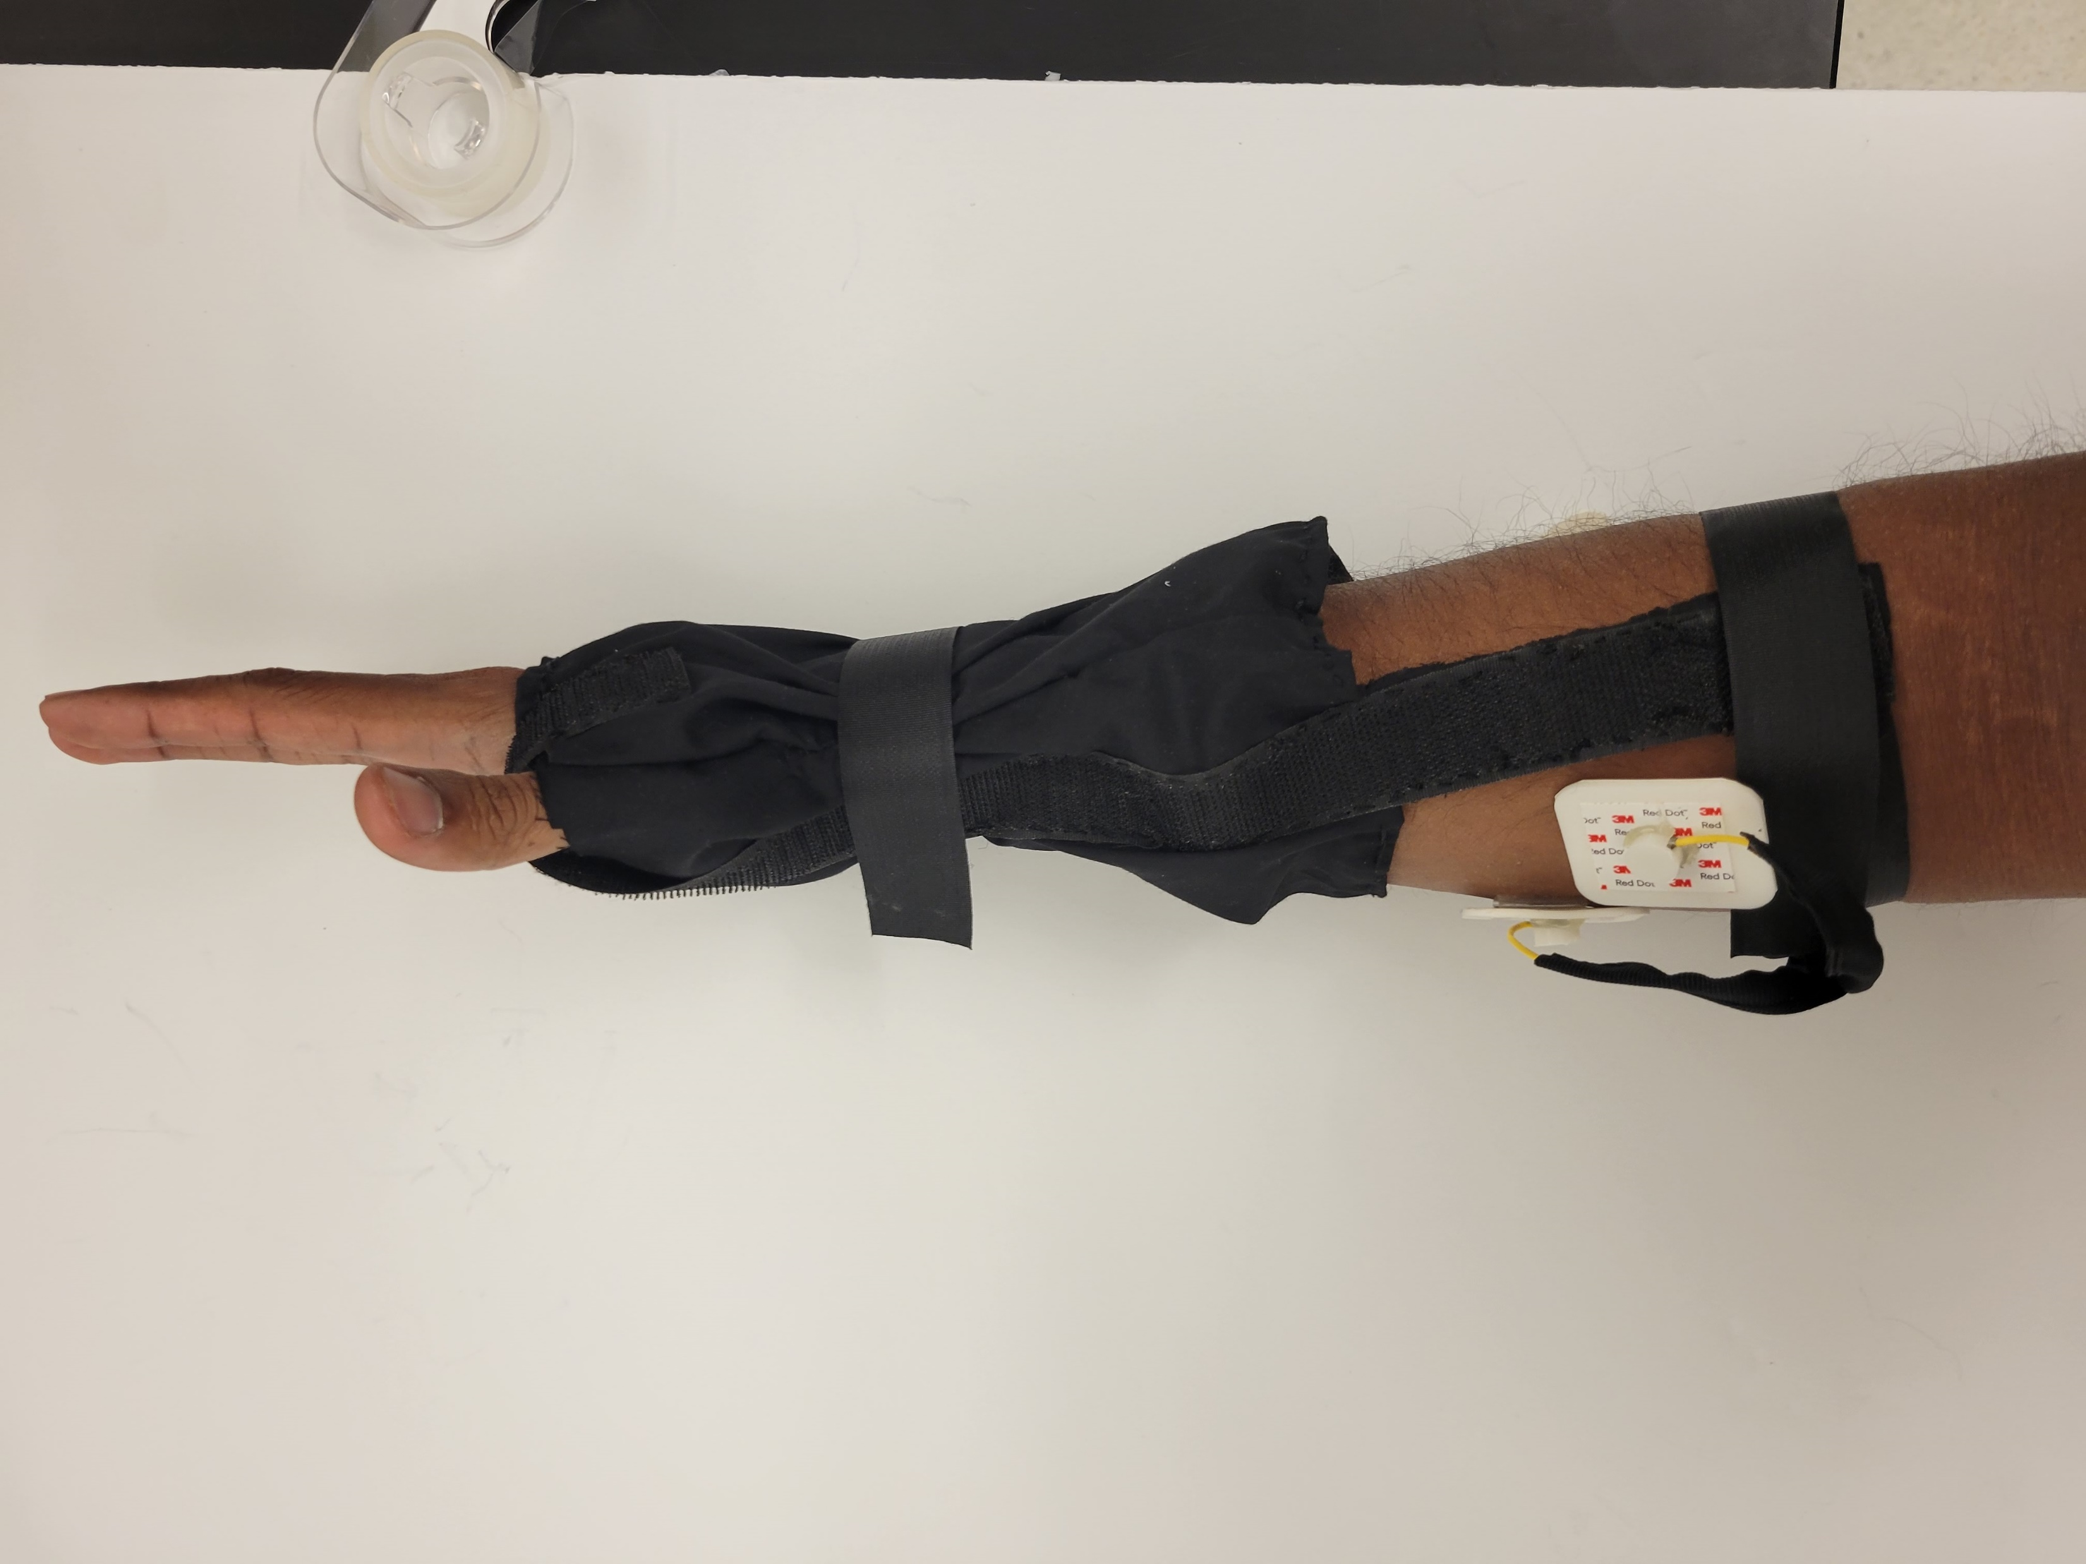

Slide 15
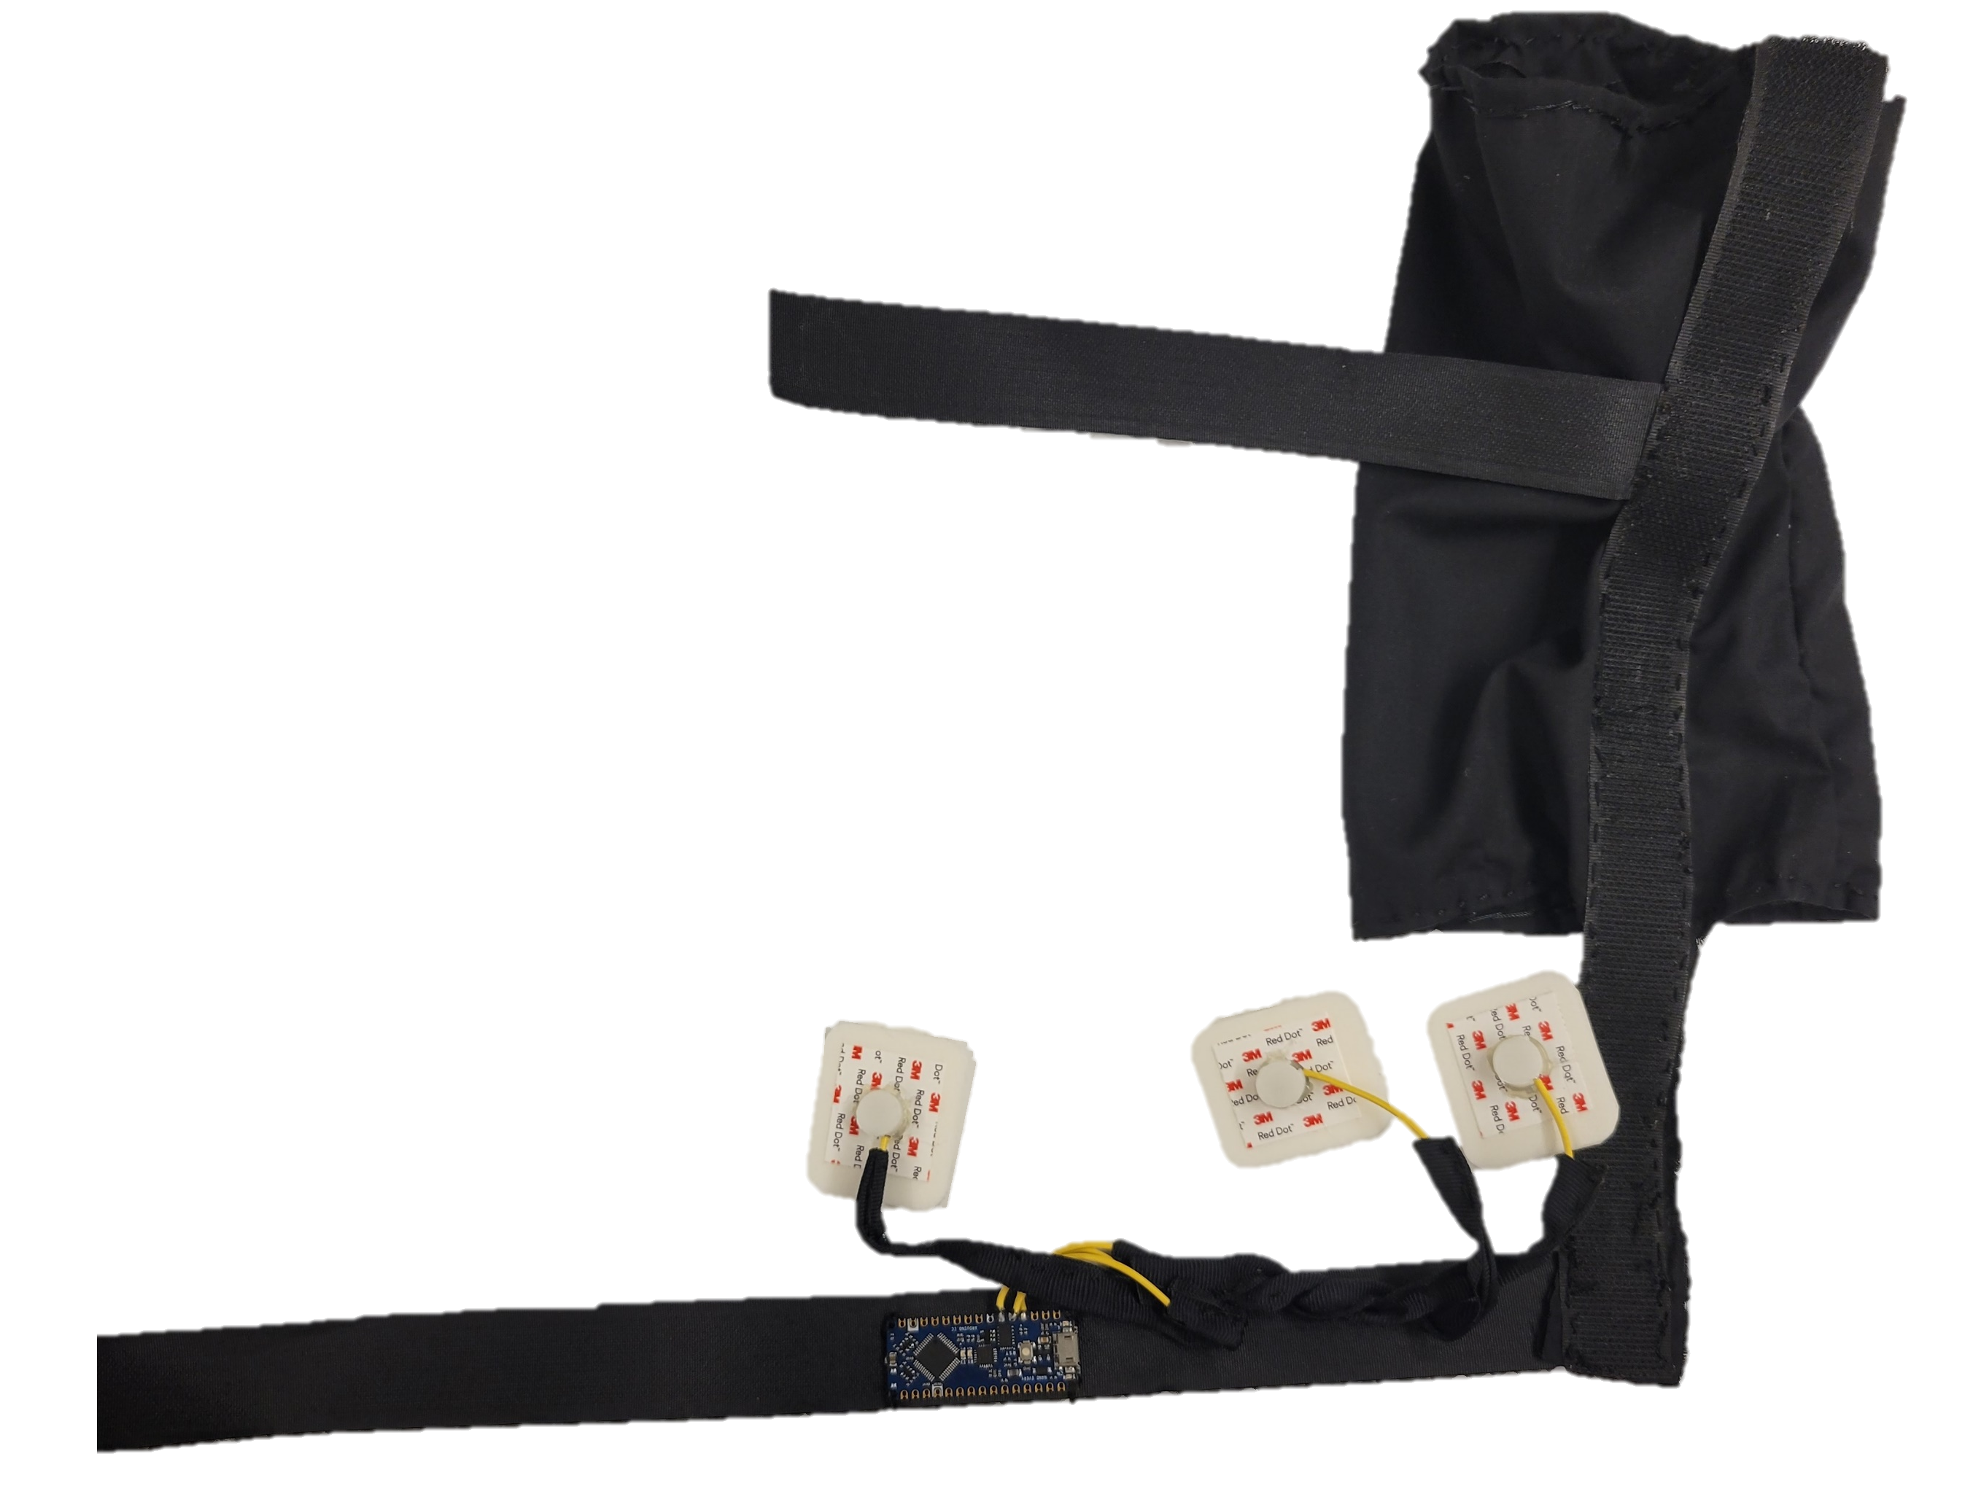

Slide 16
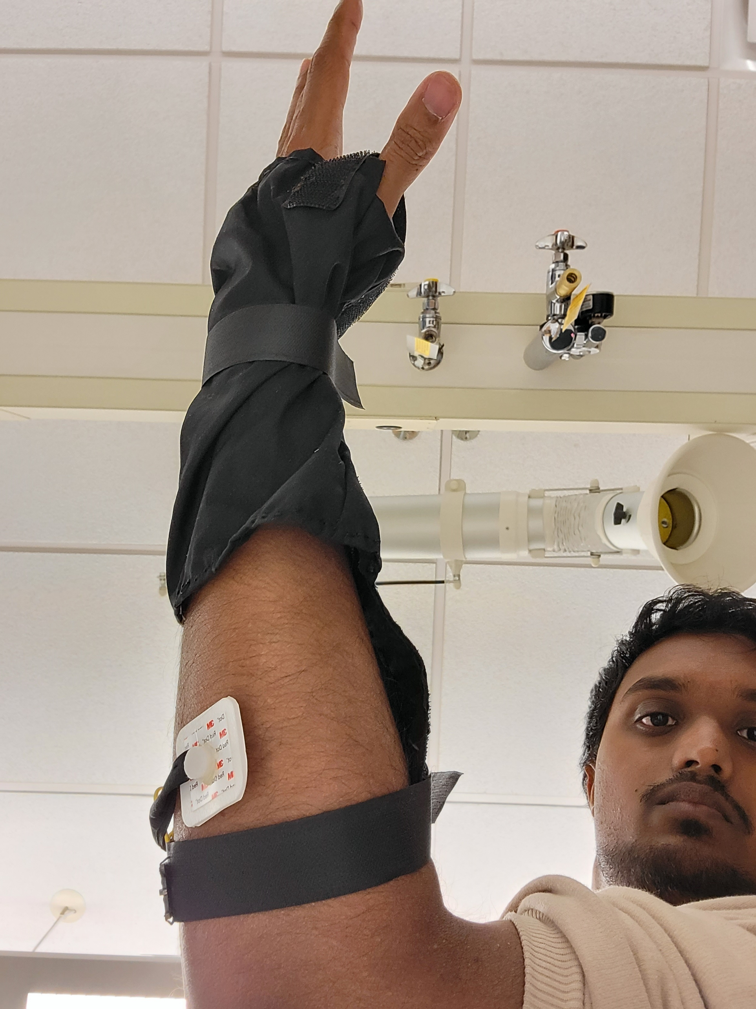
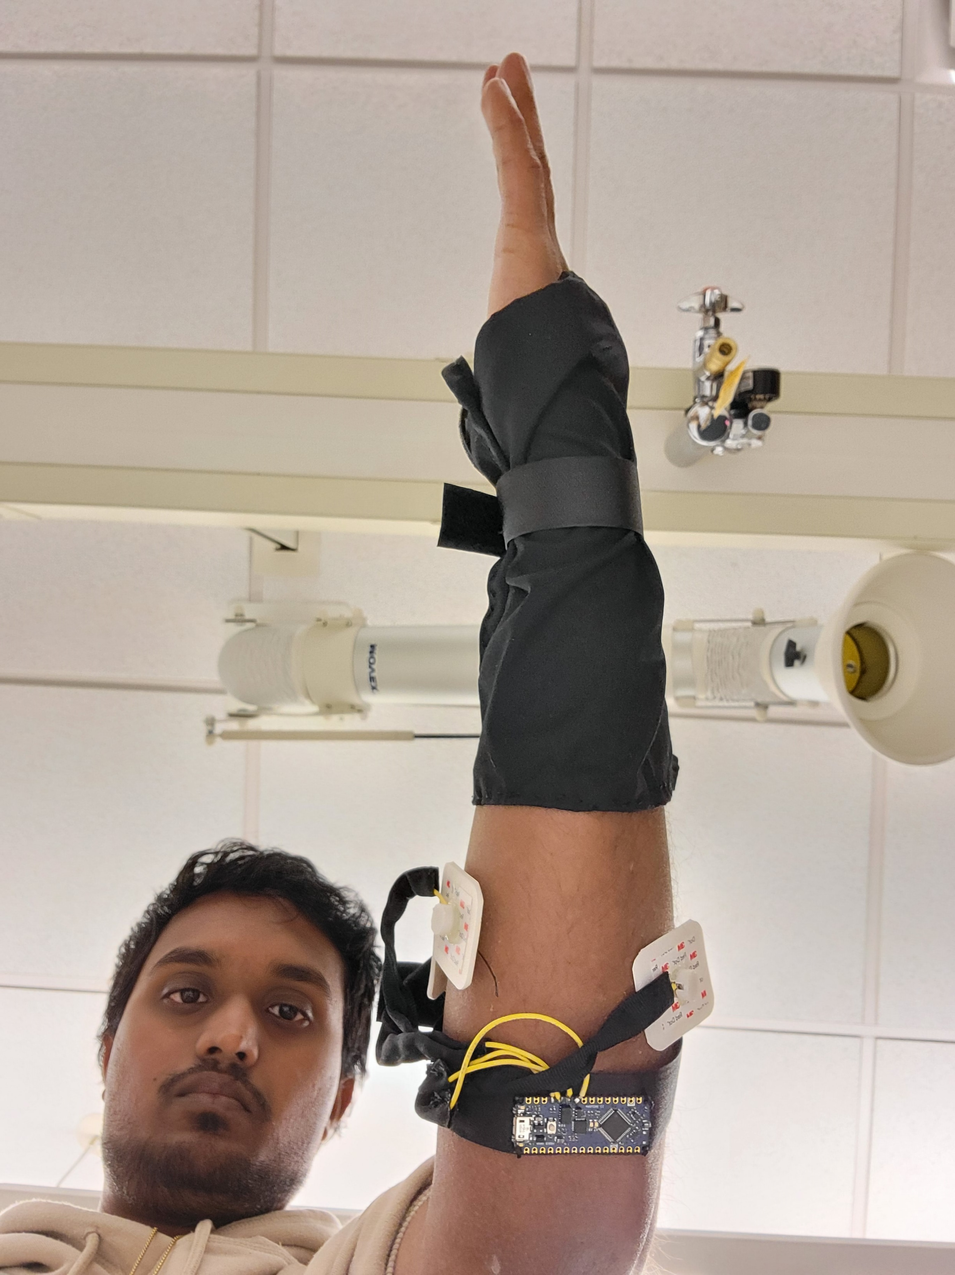
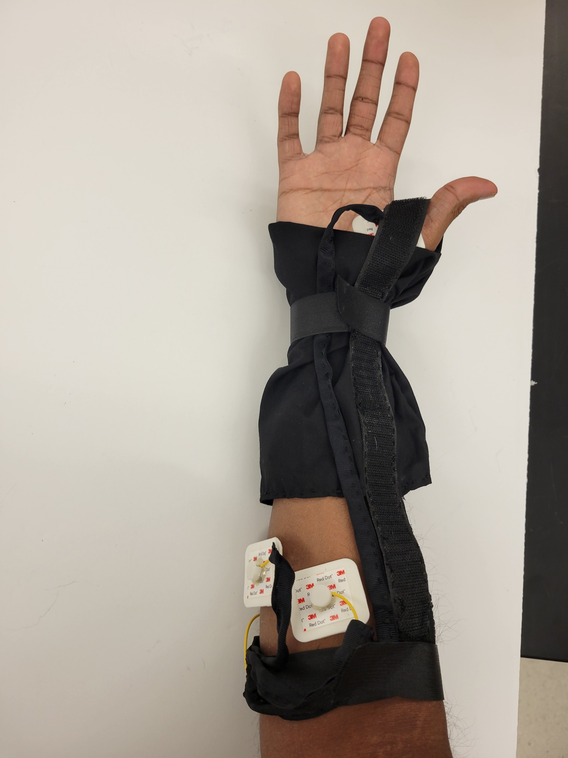
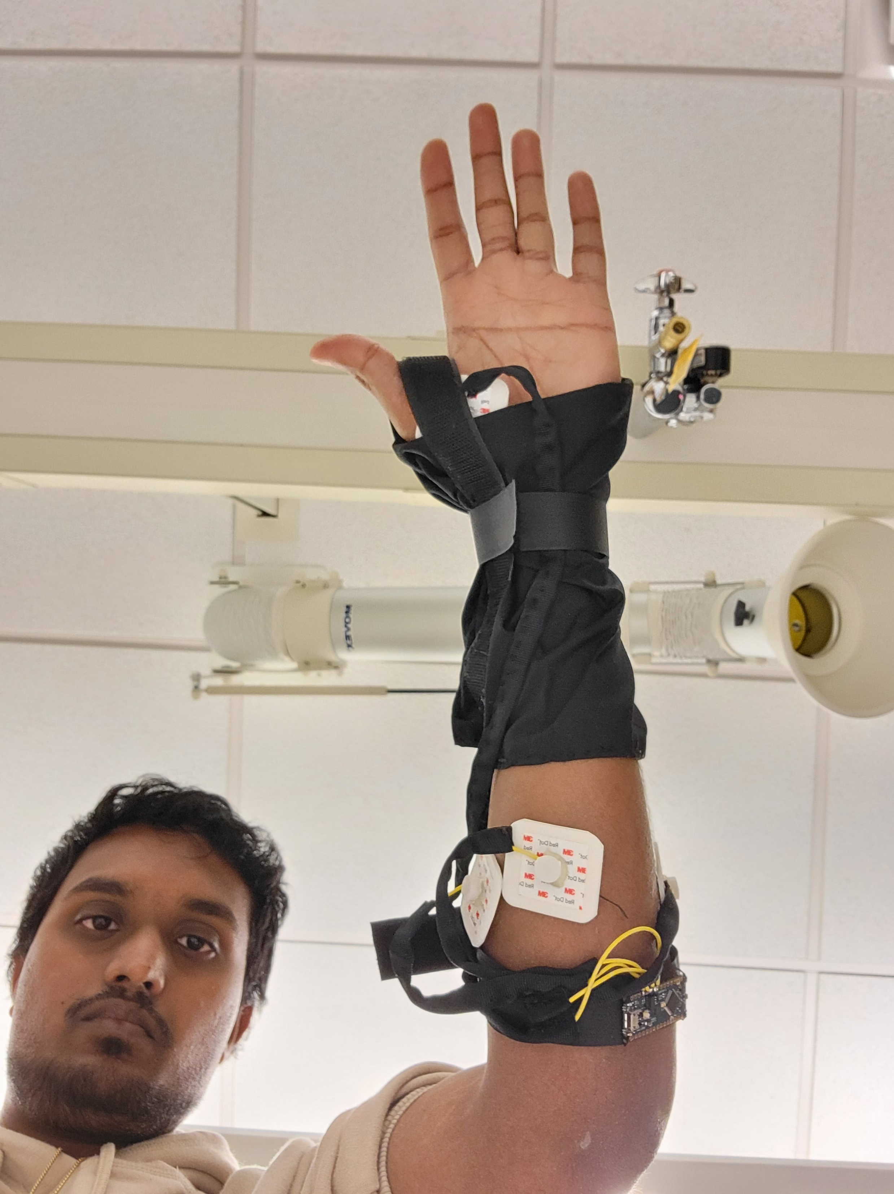
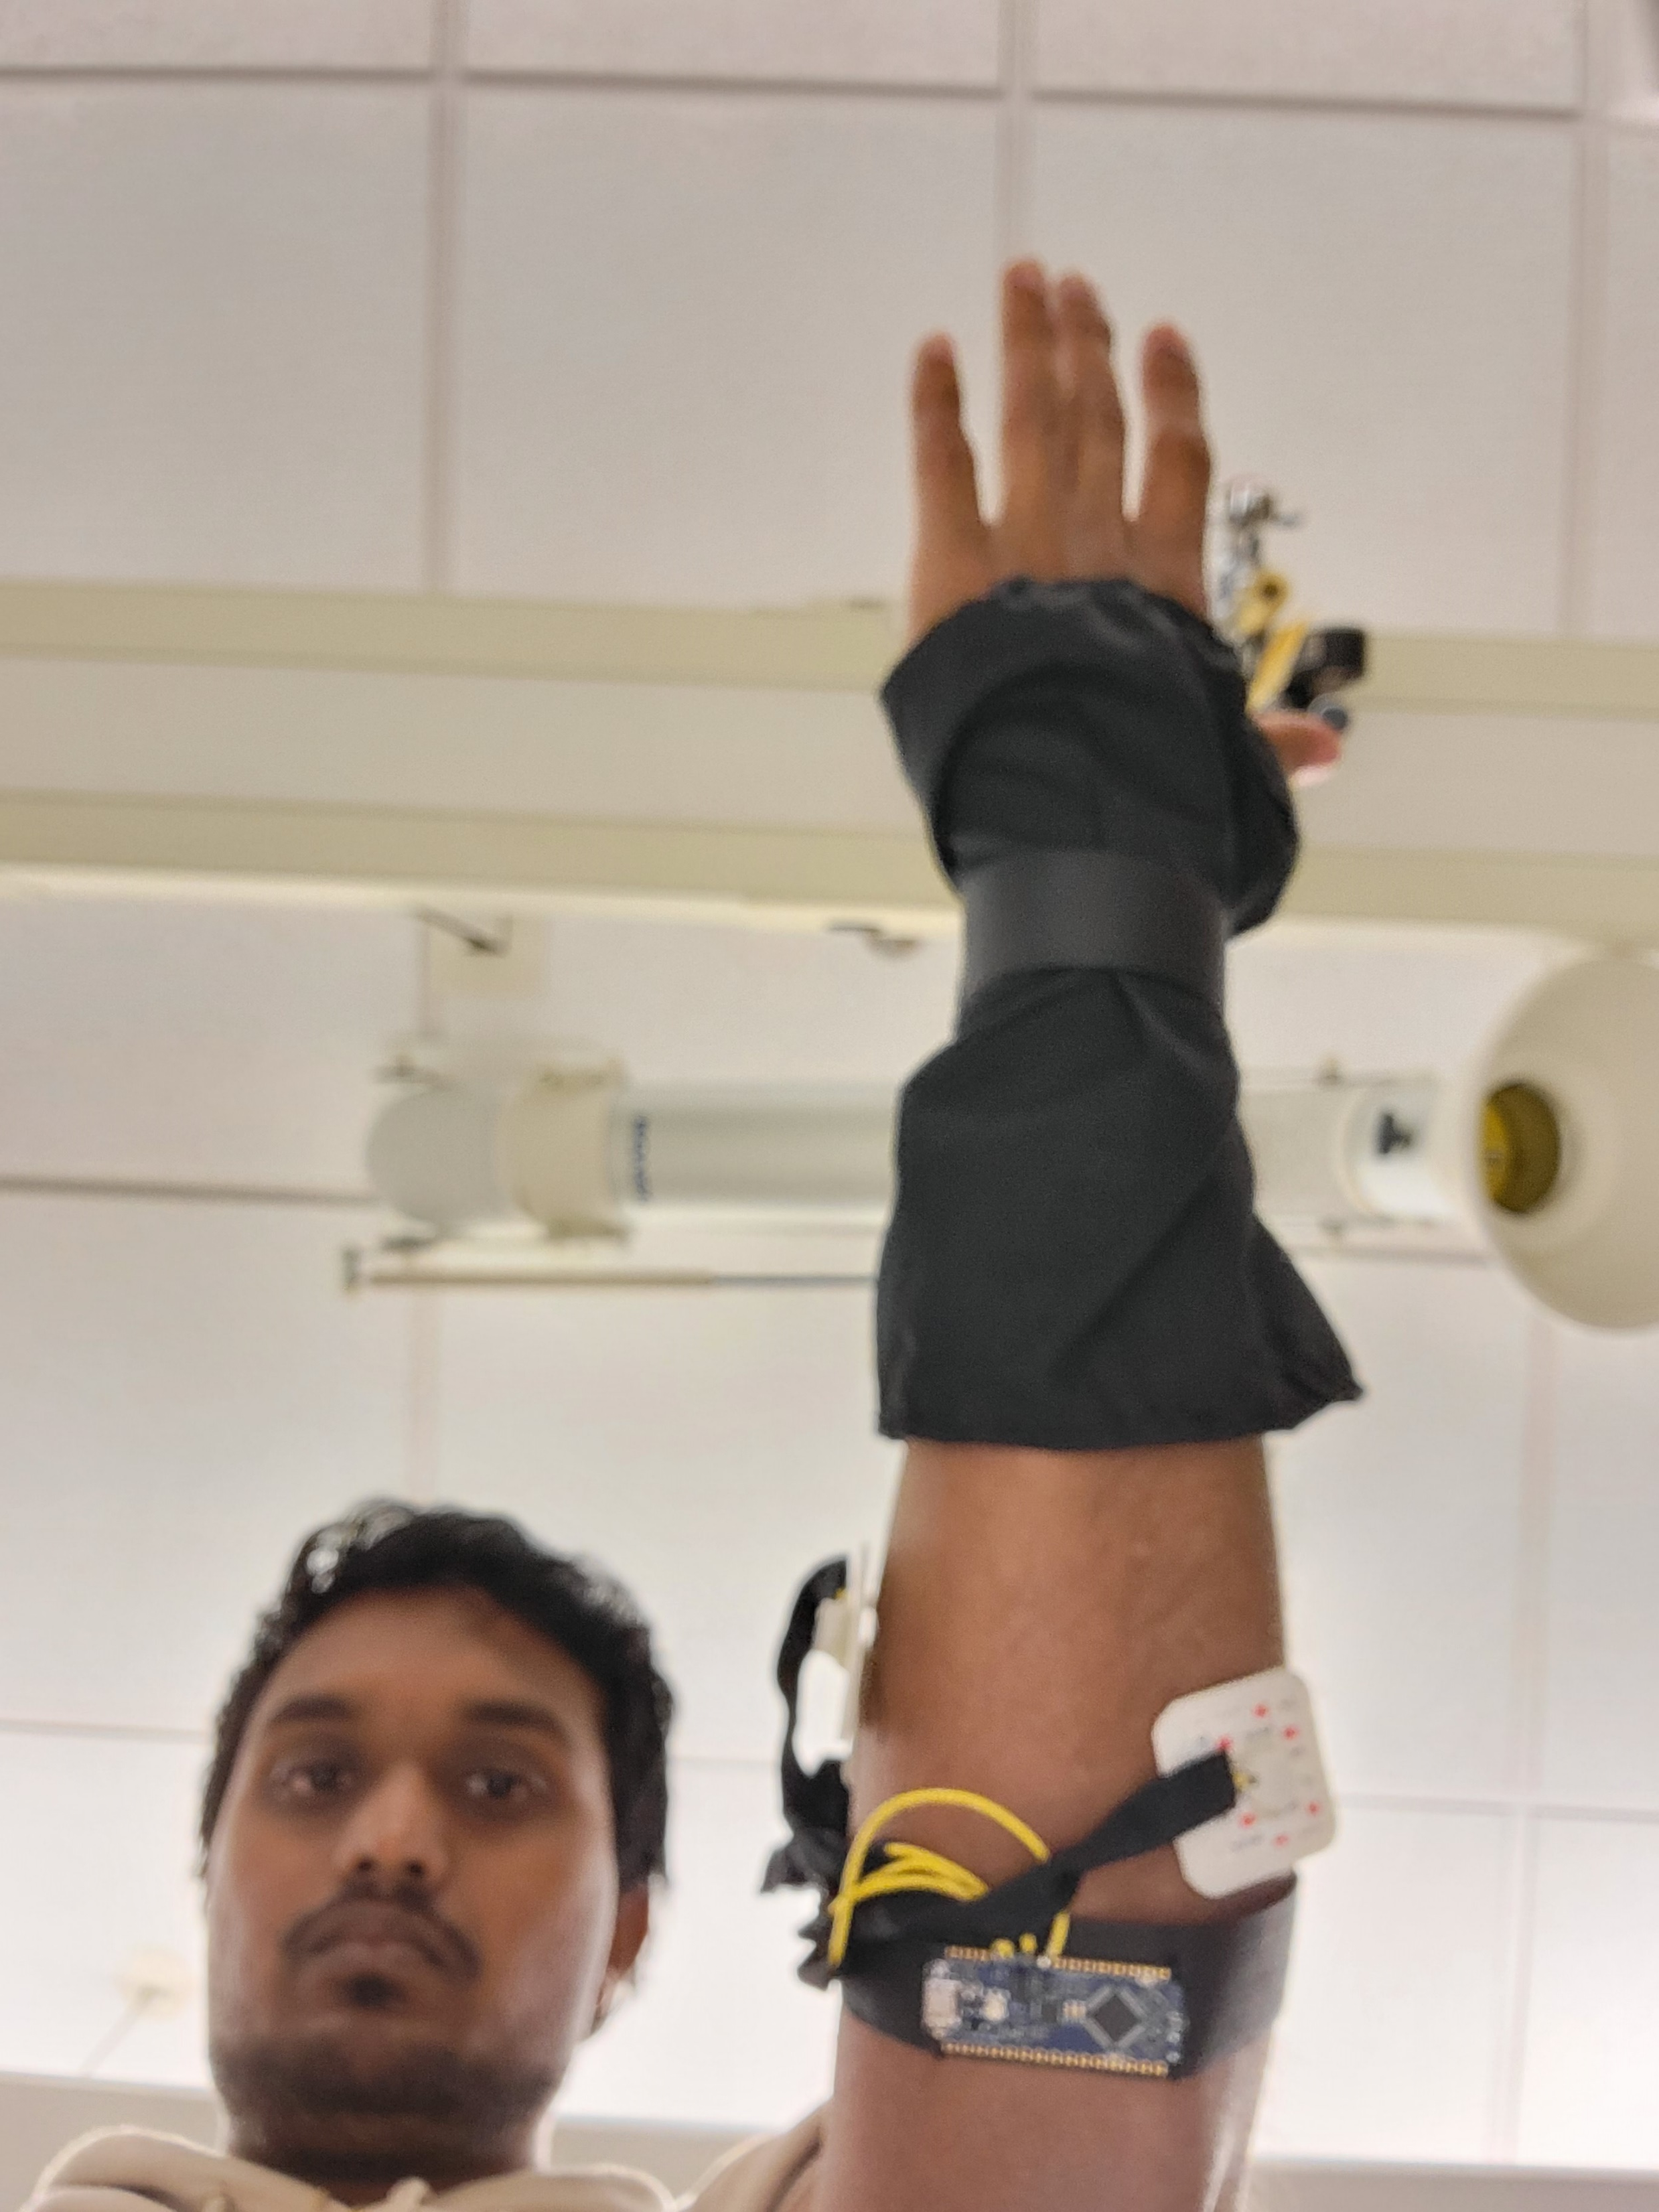
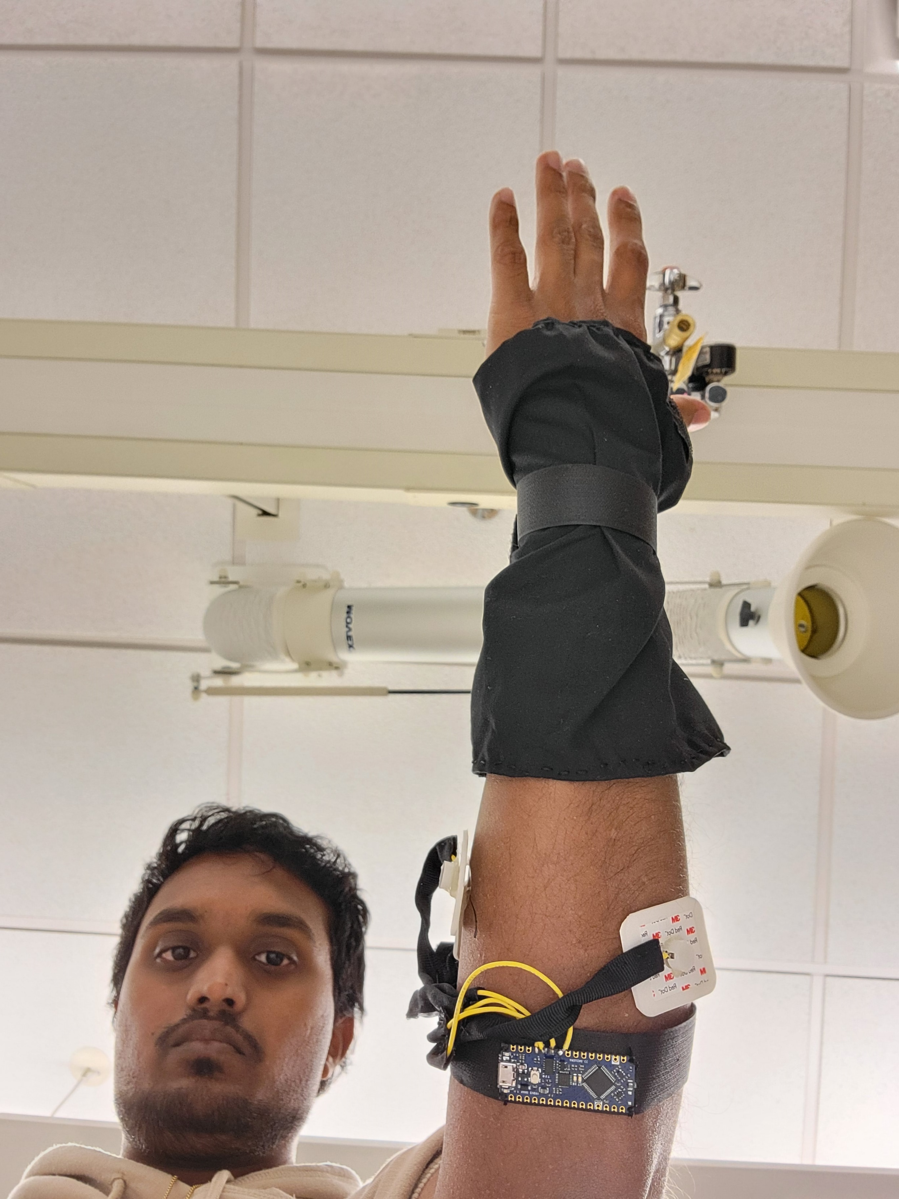

Slide 17
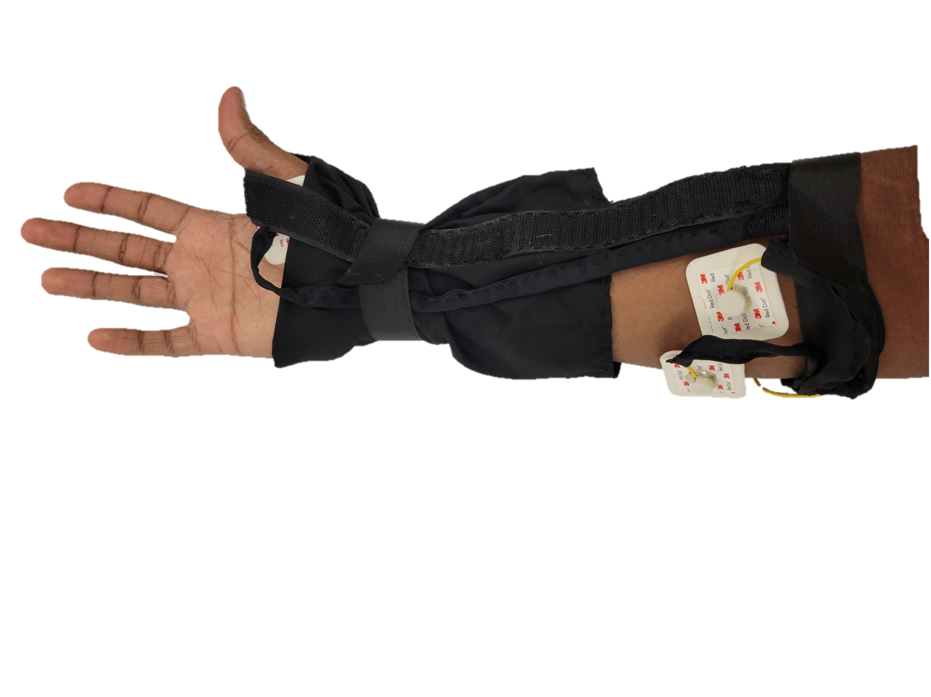
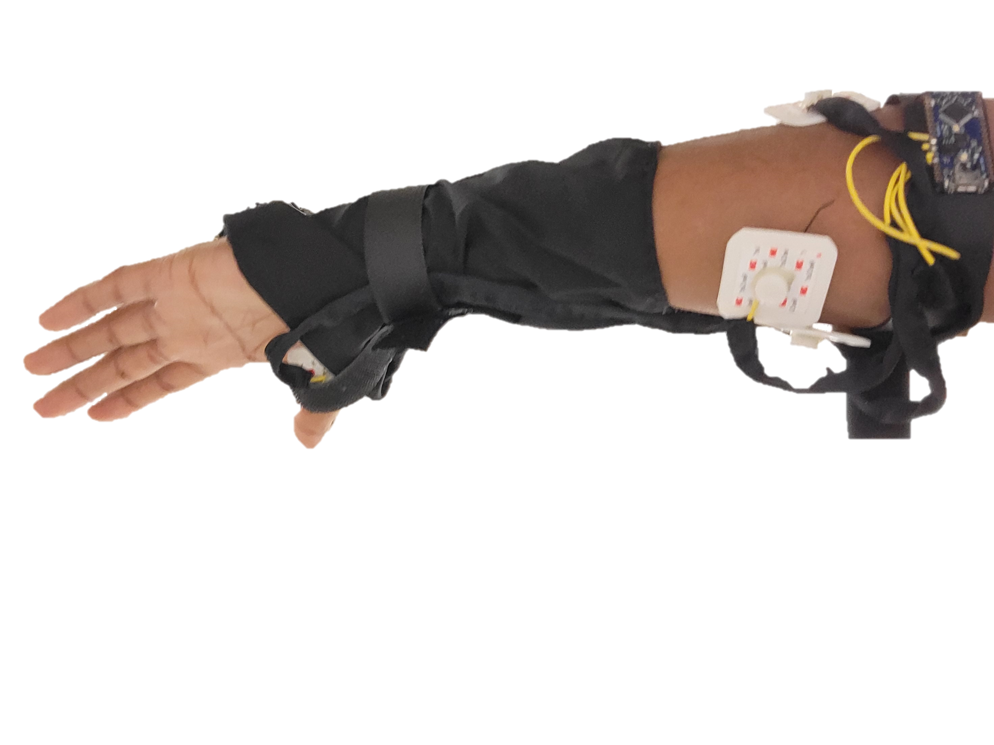
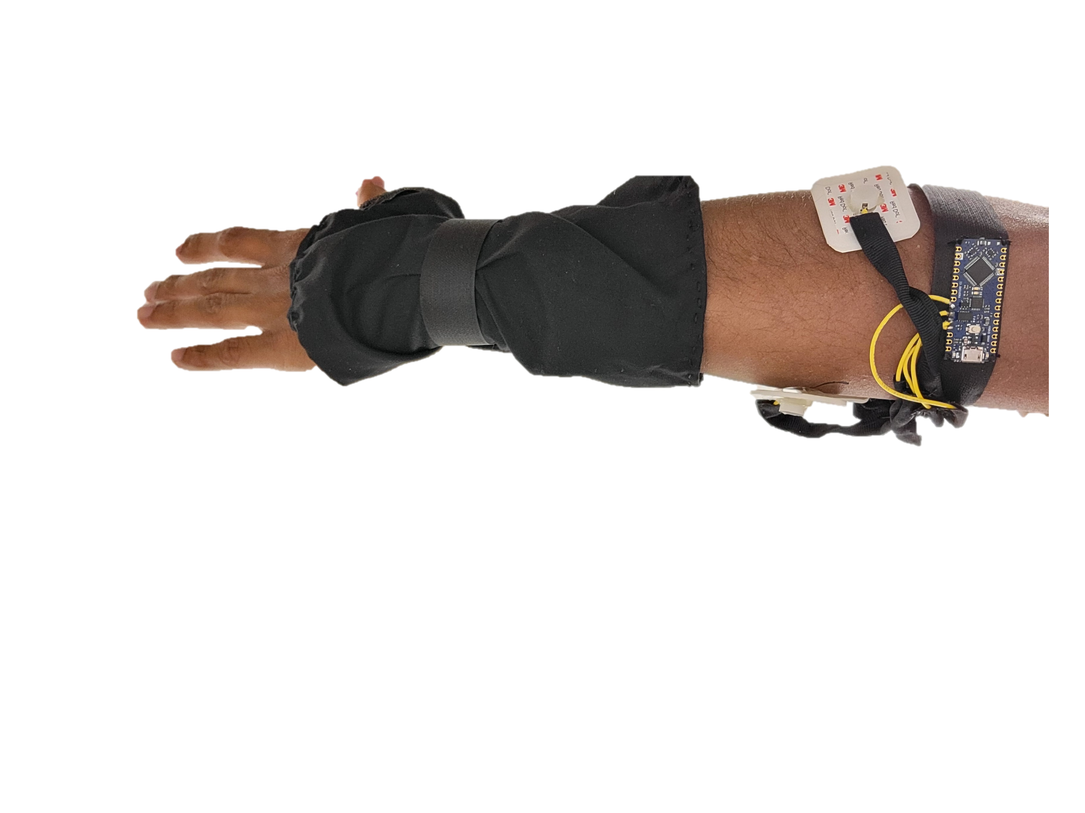

Slide 18
